Slide 1
Energy Efficiency in the Pacific Northwest
Jeffrey Davis
July 19, 2014

Slide 2
Good Audit Questions
Is equipment appropriately sized?
Is equipment off when not in use?
Is equipment used for intended application?
Are systems optimized for efficiency?

Slide 3
Keys to Successful Energy Projects
Large equipment first
Equate to many small projects
Low cost options
Controls upgrades and O&M are very cost effective
High hours of operation
Contribute to short payback period
Automatic > Manual
Add VFDs on Variable Loads
Increasingly more cost effective
50% speed ~ 15% power
$$P_{2}= {\left(\frac{{RPM}_{1}}{{RPM}_{2}}\right)}^{3}∗P_{1}$$

Slide 4
Energy Consumers
Pumps
Fans
Boilers
Lighting
Air Compressors
Chillers
HVAC
Refrigeration
Applications

Slide 5
Pump EEMs
VFD
Open Balance Valves & Triple Duty Valves
Control to pressure setpoint
Correct Size
Typically pumps operate most efficiently at full load
Correct # of Pumps
Sometimes a pump in parallel can be shut down
One large site has 10,000,000 kWh ($500,000yr) in identified pump shutdown projects
$$P_{2}= {\left(\frac{{RPM}_{1}}{{RPM}_{2}}\right)}^{2}∗P_{1}$$

Slide 6
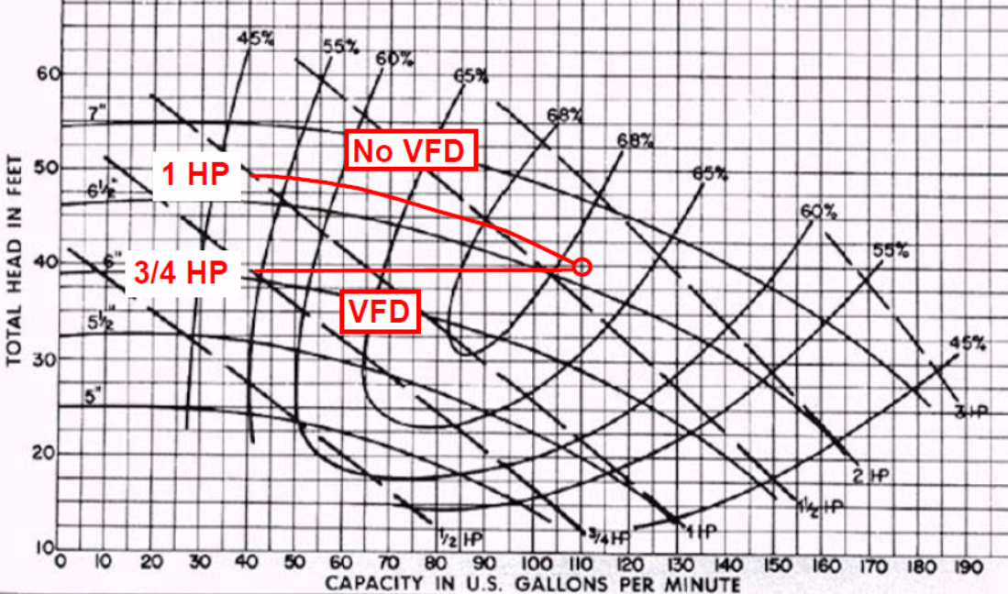
Pump VFD Analysis

Slide 7
Fan EEMs
Static Pressure Reset
Ducting applications (HVAC)
Baseline = 3” w.c.
EEM = 1.5” w.c.
Wet bulb approach controls
Cooling tower fans
VFD
Best VFD application
~50% savings
$$P_{2}= {\left(\frac{{RPM}_{1}}{{RPM}_{2}}\right)}^{2.7}∗P_{1}$$

Slide 9
Case Study: Idle Motor Shutdown
Equipment for moving wood chips:
(2) 500 HP & (1) 700 HP Blowers
Baseline: Blowers left on in “Idle” mode
Total Idle Power = 550 kW
EEM: Turn off blowers after 1hr of idle time
Reduced run time by 2,700 hrs/yr!
Cost: FREE
Savings: $75,000/yr
(1,500,000 kWh ~ 75 residences)
Payback = 1 second!

Slide 10
Boiler EEMs
Minimally heat
If you need 120°F water & 200°F water,
use (2) boilers
Minimally pressurize
If you need 50 psi steam and 150 psi steam, use (2) boilers
Automate boiler blowdown
See case study

Slide 11
Case Study: Automated Boiler Blowdown Controls
Wood Drying Equipment:
(3) 750 hp boilers
Baseline: Manual Blowdown
EEM: Automatic Blowdown
Requires control panel, conductivity probe, throttling valve, motorized blowdown valve
Cost: $8,000
Savings: $30,000/yr
(50,000 therms ~ 100 residences)
Payback = 3 months

Slide 12
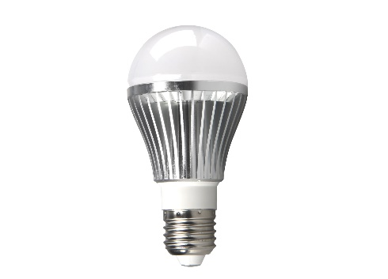
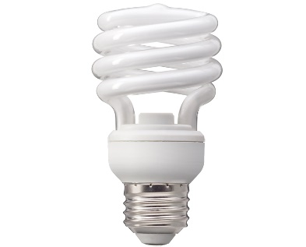
Lighting EEMs
50,000 hrs
15% power
Commercial - $$
Residential – $$$$$$
10,000 hrs
25% power
Commercial - $
Residential – $$$
1,000 hrs
100% power
Commercial – DON’T USE
Residential – $
Occupancy Controls
For noncritical tasks
Daylight Controls
Utilize the Sun
Design to IES light levels
The right amount of light

Slide 13
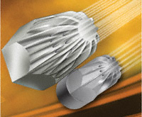
Air Compressor EEMs
Leak Repairs
Low cost, quick payback
Engineered Nozzles
Correct Applications
E.g. Don’t use for cleaning (use vacuum instead)
VFD
(1) 150 hp compressor (most efficient)
Multi-stage
(3) 50 hp compressors (most reliable)

Slide 14
Chiller EEMs
Proper Sequencing (2+ chillers)
Low/No Cost, huge savings potential
VFD
Over 50 % energy savings possible
Reduce condenser water temp
0.5 – 1.5 % power saved per 1°F change
Desuperheater
Turns waste heat into practical heating (e.g. hot water)
Automatic Volume Index (Vi) & Thermosyphon Oil Cooling (TSOC)
Efficiency new equipment options

Slide 15
Refrigeration Cycle (pressure-enthalpy diagram)
2
Pressure or
Temperature
Condensing Water Temp
1
Work (kW)
Enthalpy

Slide 16
Case Study: Compressor Sequencing
Pasteurizer Cooling Equipment:
4 compressors (total 1,650 HP)
C3 & C4 new with VFDs
C1 & C2 old w/o VFDs
Cost: $28,000
Savings: $17,000/yr
(200,000 kWh/yr ~ 10 residences)
Payback = 1.6yrs

Slide 17
Typical HVAC EEMs
Avoid simultaneously heating and cooling
Minimally cool & heat
Minimally ventilate
Fan, heating & cooling savings
“Sick Building Syndrome” led to many over-ventilated spaces in the 1980s
Use VAV system when serving multiple zones
Supply air temperature reset
Heating and cooling savings
Static pressure reset
Fan savings
Schedule temperature setbacks when unoccupied
Economize (“free cooling”)
Cooling savings
Economizers are often broken

Slide 18
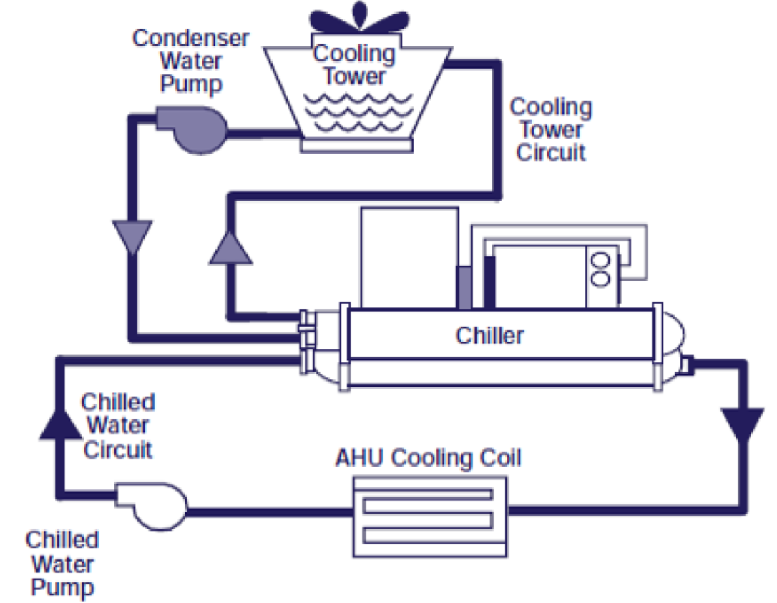
HVAC Cooling System
Fan VFDs
Oversized Cooling Tower
Wet Bulb Temp Approach
Lower CW Temp
VFD Chiller
Auto Vi & TSOC
Sequencing
(2+ chillers)
EEM Opportunities
Air Side
Static Pressure Reset
Supply Air Temperature Reset
Scheduling (temp setbacks)
VFD CHW Pump

Slide 19
Typical Refrigeration EEMs
Compressor VFD
Evaporator VFDs
Condenser Fan VFDs
Control System
Defrost Float Drainers
TSOC in lieu of LIOC
Variable Vi
Oversized Condenser (reduces CWT)
Hot Gas Defrost
Desuperheater for Under Floor Heating

Slide 20
Screw Compressor VFD
Motor speed will vary to maintain suction pressure
Once motor speed reaches minimum speed (~40%), the screw compressor will begin to unload on the slide valve
On highly variable loads such as cold storage applications, this is a cost effective measure

Slide 21
Evaporator & Condenser Fan VFDs
Evaporator Fans
Fan speed modulates to maintain zone temperature
Be cautious of minimum fan speed recommendations b/c air flow must be delivered long distances in cold storages
Baseline operation is continuous fan operation or fan cycling (with cycle time to accommodate defrost)
Condenser Fans
Fan speed modulates to maintain condensing pressure
Baseline operation is fan cycling, typically with pressure switches

Slide 22
Control Systems
Dynamic compressor staging
Floating suction pressure
Floating condensing pressure with ambient wet bulb
VFD Control
Defrost control
Liquid runtime
On demand

Slide 23
Evaporator Defrost
Electric
Electric resistance coils are located between the rows of an evaporator coil as well as in the drain pan.
This type of defrost is typical in commercial and packaged refrigeration applications.
Water
Water from 50°F – 100°F is washed over the exterior surface of the coil.
This is typical in nurseries, blast freezers, IQFs or anywhere the air quality is not ideal as this cleans the coil surface in the process.
Hot gas
Superheated discharge refrigerant gas is directed through the drain pan and coil.
This is a great method for defrosting since this is free heat
This is typical for industrial applications with built up systems.

Slide 24
Defrost Control
Fixed Time of Day
Each evaporator defrosts via a mechanical time clock.
This type of defrost is independent of coil load or ice accumulation.
This is typical in commercial and packaged industrial refrigeration applications (most likely with electric defrost).
Liquid Runtime
Cumulative runtime of liquid line solenoid valves are monitored. Once the runtime equals a predetermined value, the evaporator will initiate a defrost cycle.
This is typical of hot gas defrost evaporators in built up industrial systems
On Demand
This is a newer technology
Intelli-Frost by Logix is gaining popularity and proving to be an efficient alternative to liquid runtime defrost strategy
Defrosts are necessary to maintain adequate heat transfer across the coil, but introduce additional load into the refrigerated space which must then be removed.

Slide 25
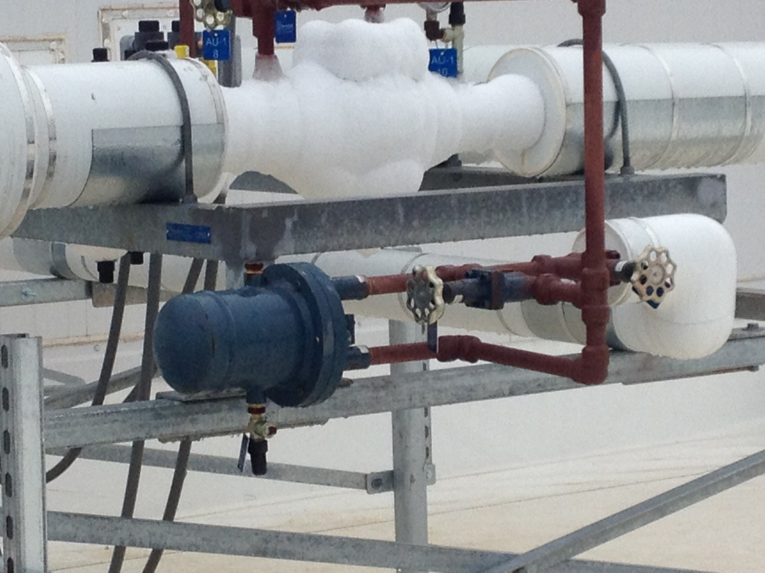
Defrost Float Drainers
Float drainers fully condense defrost vapor which then gravity drains to the LPR. This prevents defrost vapor from entering compressor inlet and creating a false load due to increased mass flow.

Slide 26
Oversized Condenser
Use the surface area of the condenser to your advantage.
Oversizing a condenser will lower the approach temperature between the ambient wet bulb temperature and the saturated condensing temperature.
This will allow for lower condensing pressures whenever possible.
Typical Baseline: 90°F SCT / 68°F WBT
Typical EEM: 85°F SCT / 70°F WBT

Slide 28
The End
If you want a copy of this presentation, please let me know

