Slide 1
Electric Vehicles
Challenges and the Future

Slide 2
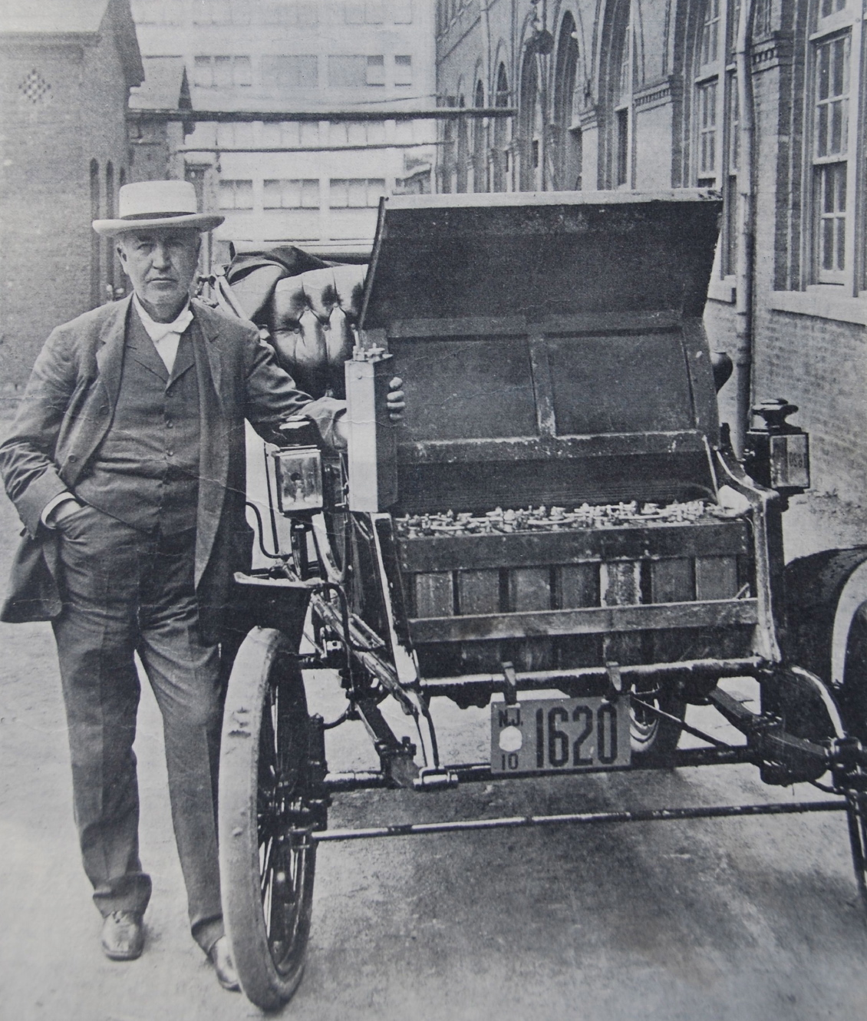
The Past
“Old” Golden Era
1880’s to 1910’s
~40% of cars on the road are electric in 1910

Slide 3
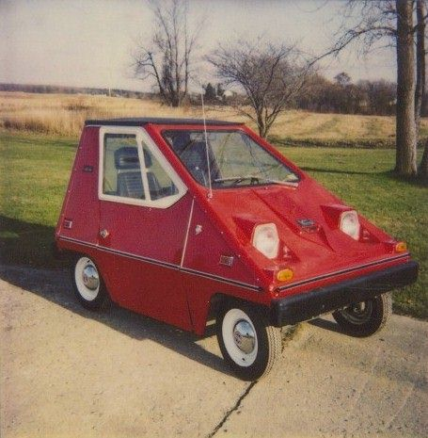
Resurgence
Oil crisis of the 1970’s
jumpstarts the call for fuel efficiency and alternatives to gas.

Slide 4
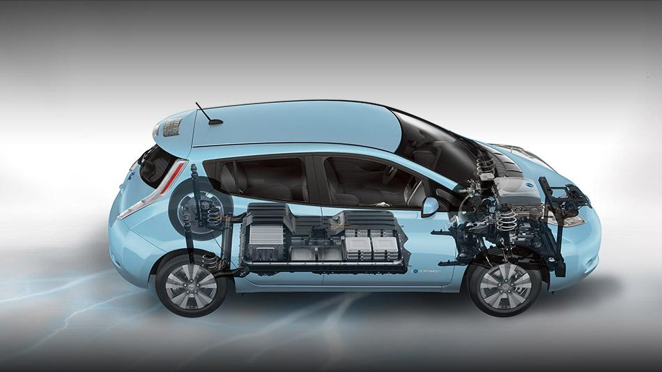
Today
Almost all the major car manufacturers have a Plug in EV or will in the next decade.

Slide 5
Outsiders

Slide 6
Challenges
Hydrogen
Battery Tech
Power Infrastructure
American Car Culture
Cities
Sharing Economy

Slide 7
The Future
"The future is a riddle only time can solve."
The Riddler

