Slide 1
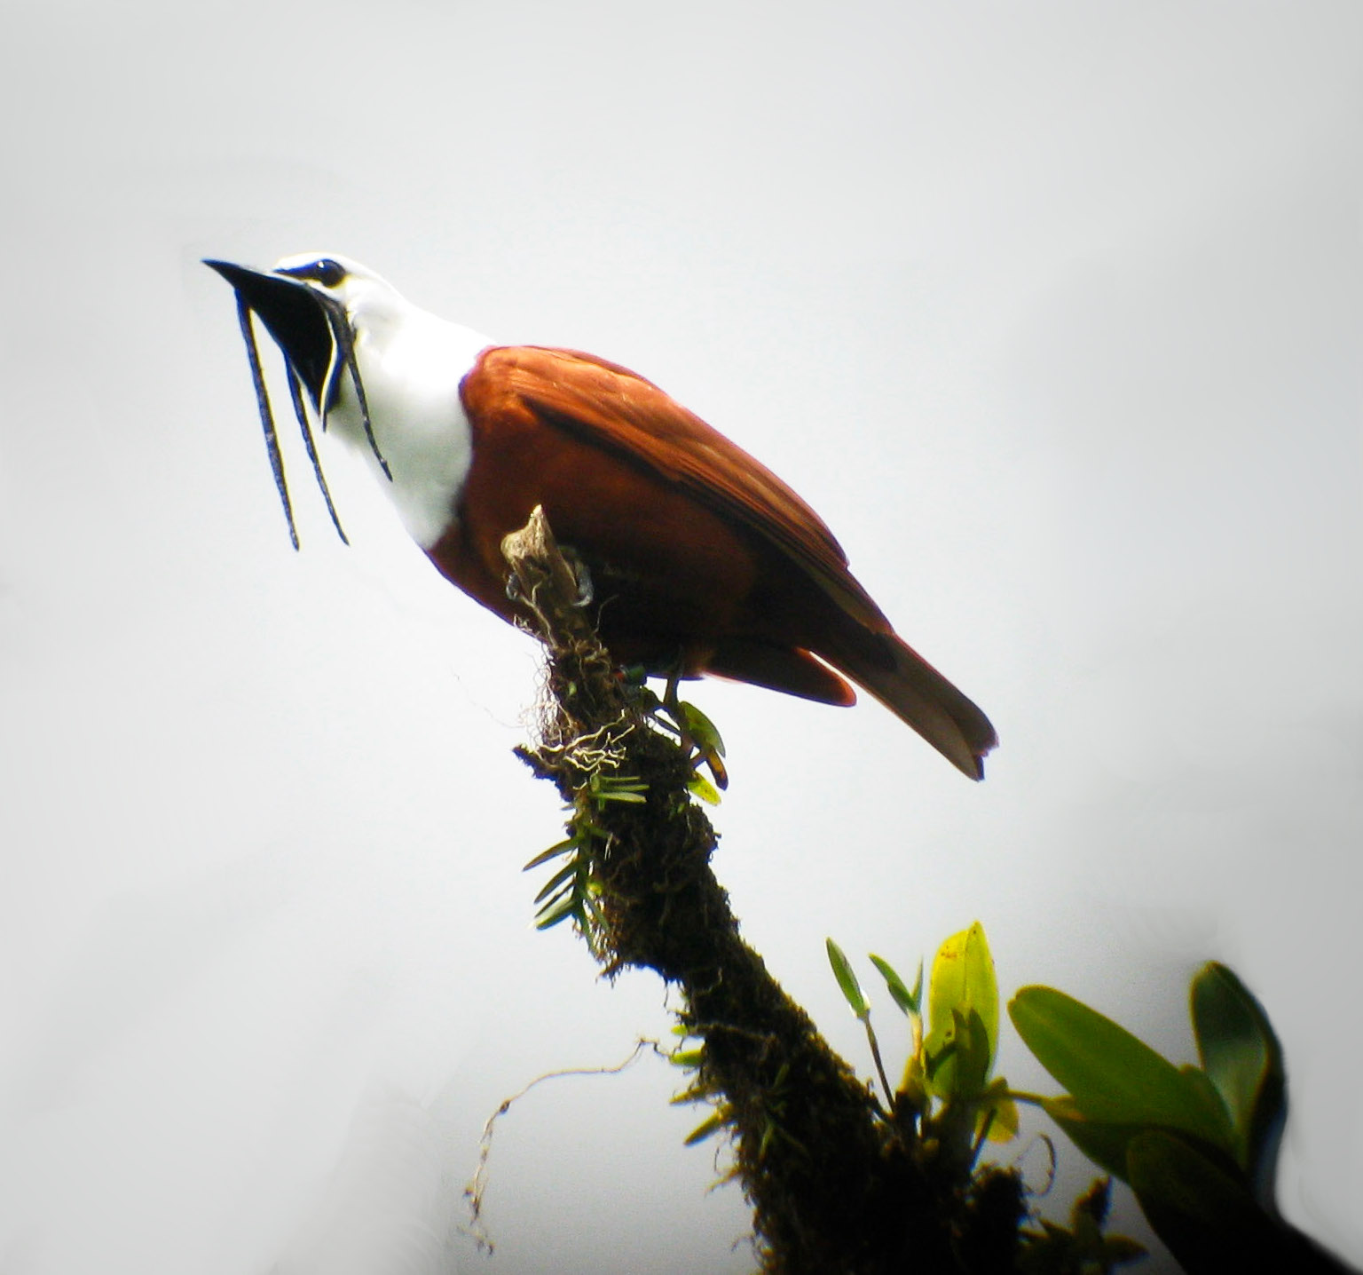
Computational Genetics
Unlocks the Basis for
Birdsong & Human Speech
Morgan Wirthlin
Dept. Behavioral Neuroscience
Oregon Health & Science University
Notes:
Thanks for having me!

Slide 2
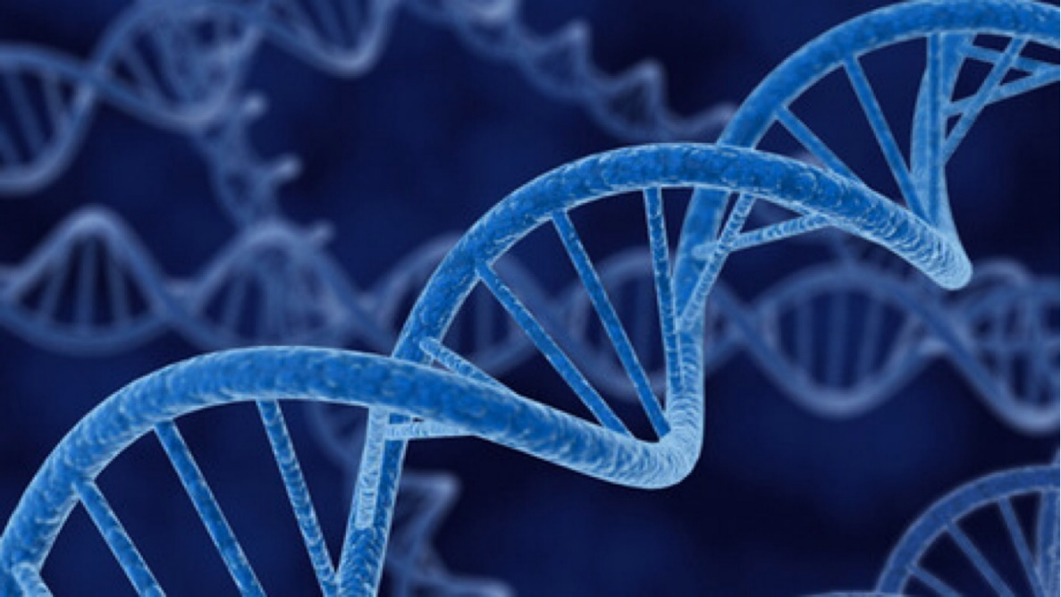
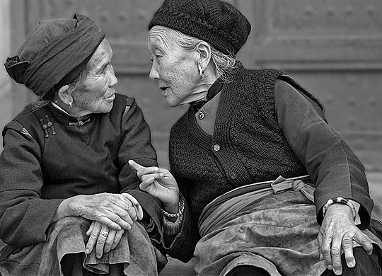
Notes:
Behavior: learned or genetic?

Slide 3
What is the Genomic basis of
Complex, Learned Behavior?
How do learned behaviors evolve?
How can we treat underlying causes of
behavioral pathologies?
Notes:
Genomic basis of complex, learned behavior?
depression / bipolar / schiz… as well as intelligence… are hugely heritable
GWAS fails to explain much… natural mutations like FOXP2 are few and far between…
And human-centric studies like these only explain part of the system that you can lose and still be viable!

Slide 4
Approach: novel computational pipelines
informed by evolutionary systematics
Identify: novel, lineage-specific genes subserving behavior
Identify: critical, ‘core’ gene networks underlying behavior
Identify: regulatory elements driving core gene expression
Notes:
Want to identify role of gene evolution in behavioral evolution
want to take strategy to find ‘core’ components that are necessary and sufficient for behavior
Do changes in regulatory elements result in new behaviors? What does that look like?

Slide 5

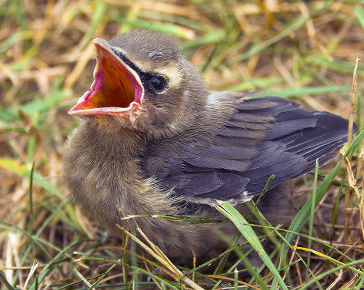
Birdsong: a model for vocal learning
Notes:
Premier model the for study of complex, learned behavior is songbird vocal learning
Despite the gap between humans and birds, who last split 320 MYA, several advantages I’d like to lay out:

Slide 6
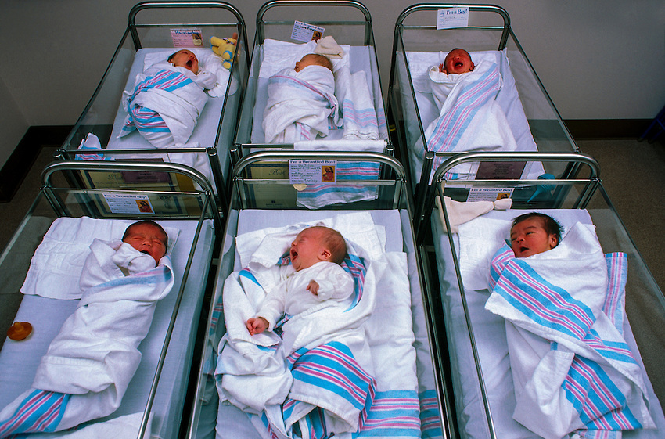
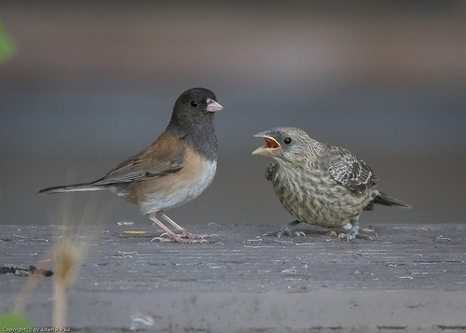
Birdsong as a model for vocal learning
i) dependent on learning
Notes:
Cross-fostering! Shows incredible plasticity and adaptability for this system to learn complex rules

Slide 7
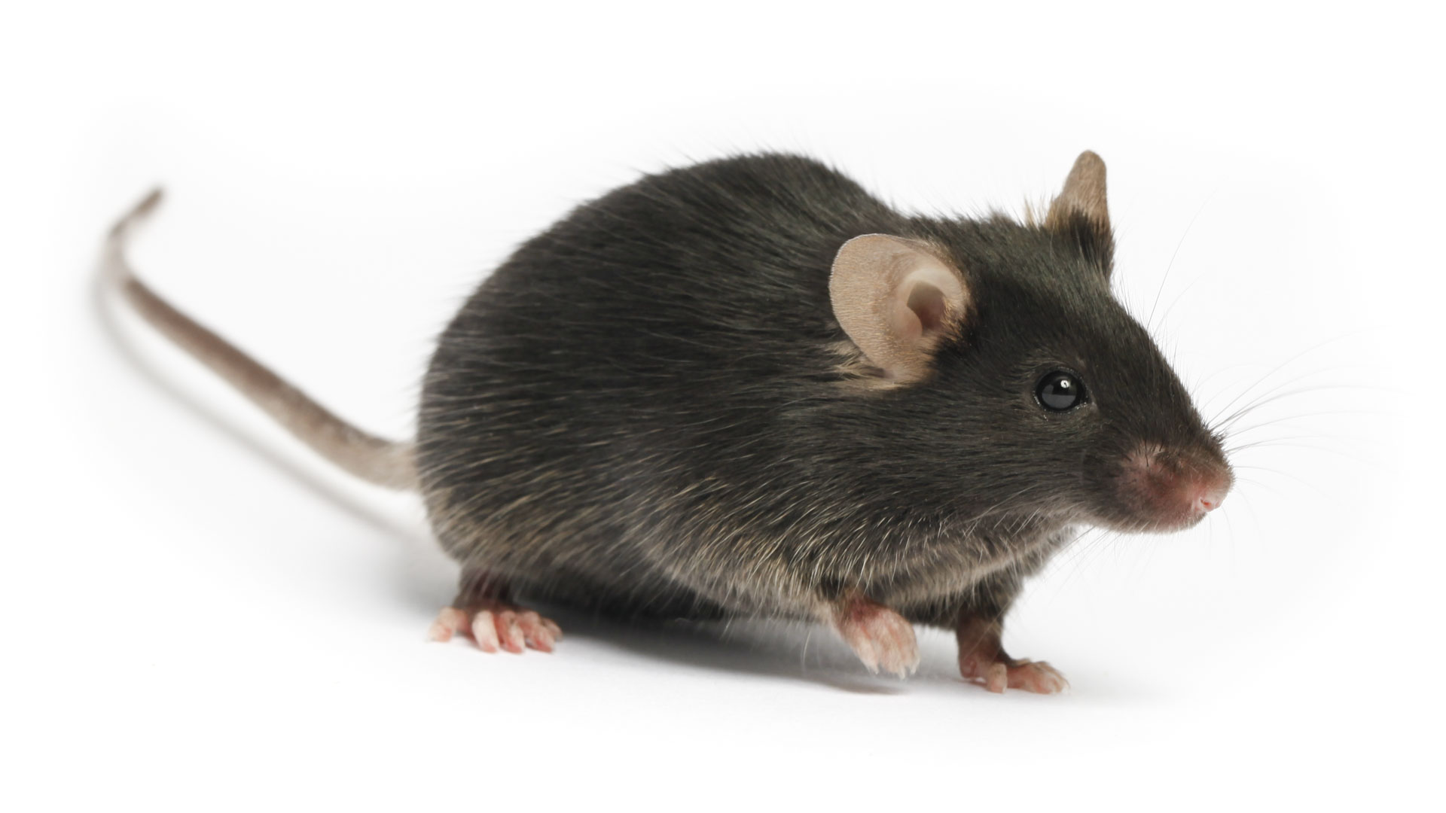
‘Calls’ not dependent on learning!
Mice deafened at birth:
‘calls’ develop normally
Mice born with no cortex:
‘calls’ develop normally
Hammerschmidt et al (2012) BMC Neuro
Mahrt et al (2013) JNeurosci
Hammerschmidt et al (2015) Sci Rep

Slide 8
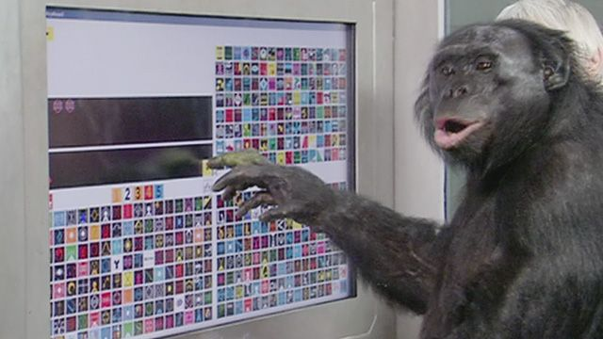
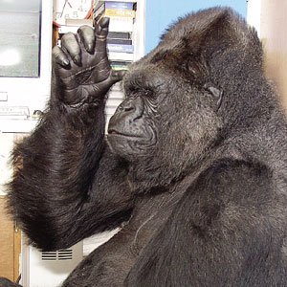
Kanzi the bonobo Koko the gorilla

Slide 9
Birdsong as a model for vocal learning
i) dependent on learning
ii) critical periods

Slide 10
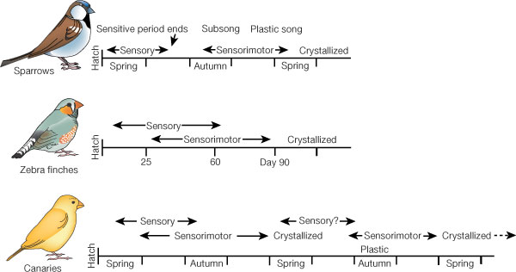
Notes:
Unlike other leaning paradigms in rodents, which rely on navigation, we can control the *Second* a bird hears its first song, allowing us to explore the mechanisms subserving plasticity

Slide 11
Birdsong as a model for vocal learning
i) dependent on learning
ii) critical periods
iii) babbling phase

Slide 12
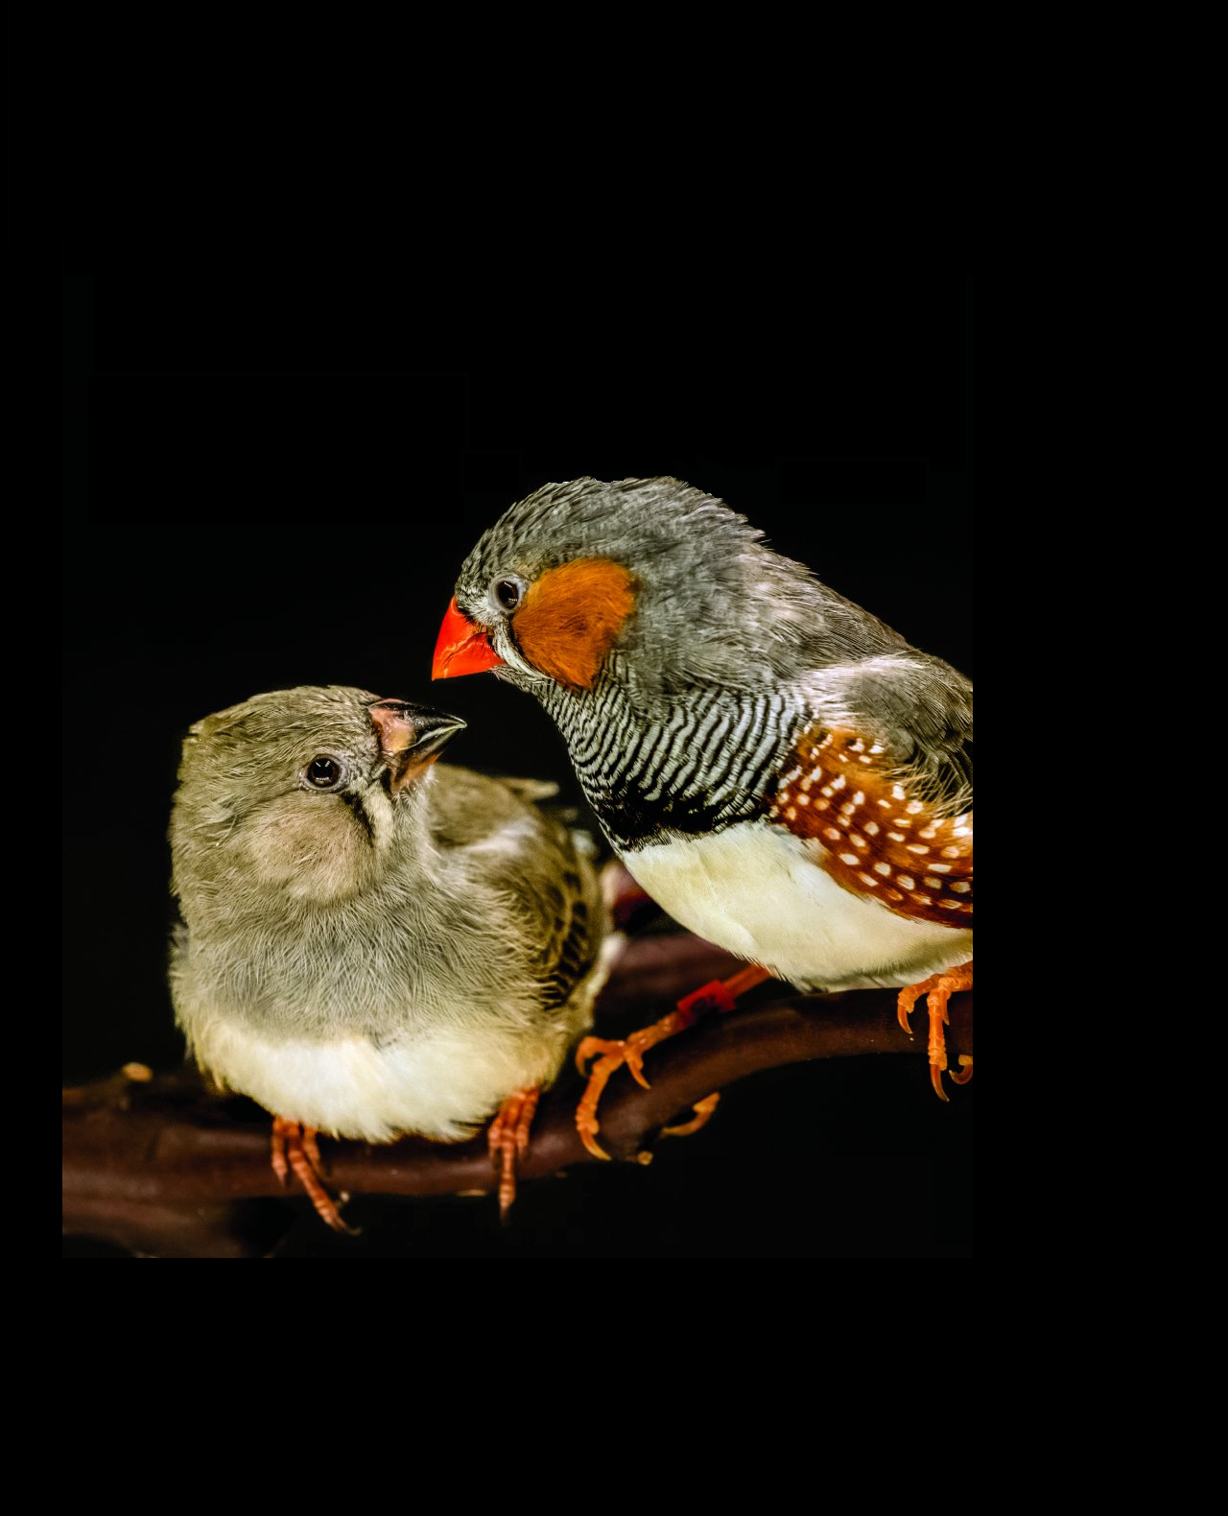
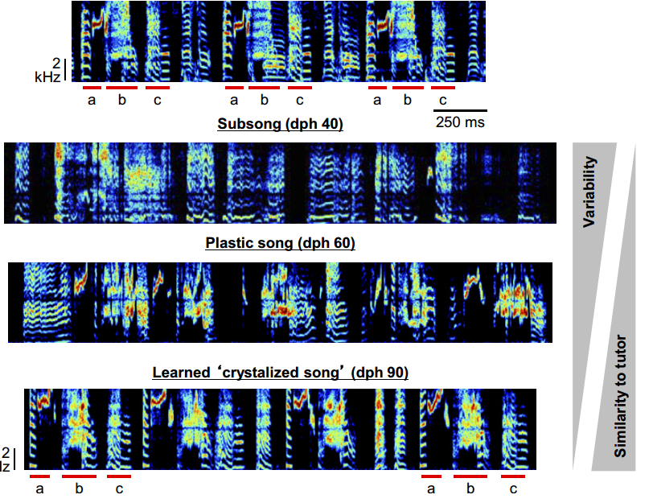
Adult tutor song
Fee & Goldberg (2011) Neuroscience

Slide 13
Birdsong as a model for vocal learning
i) dependent on learning
ii) critical periods
iii) babbling phase
iv) dialects

Slide 14
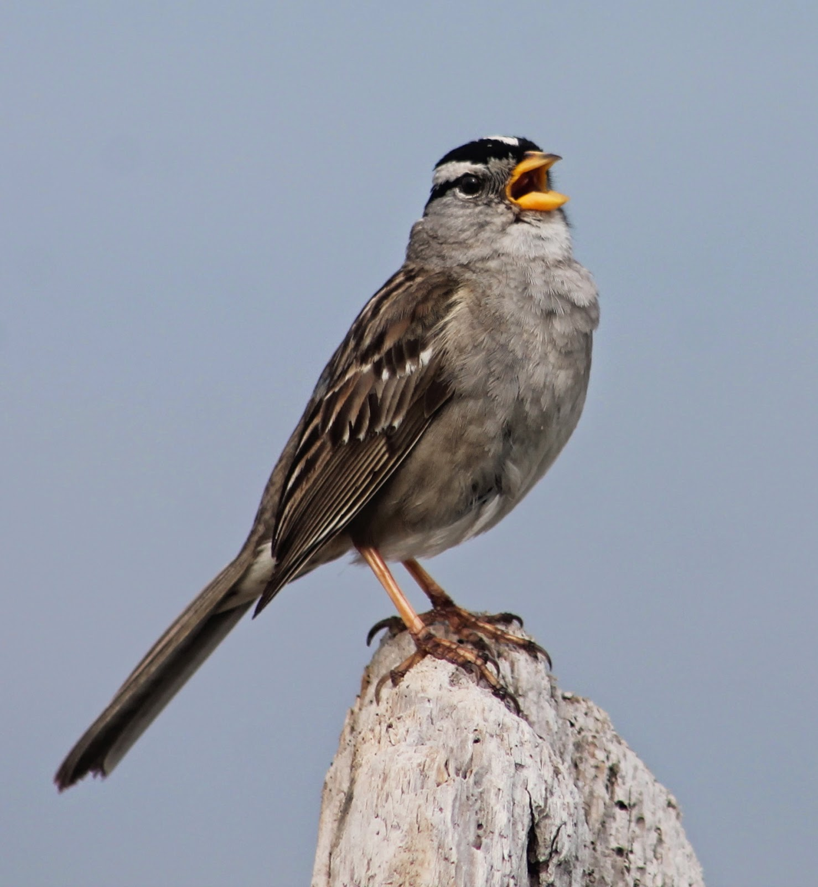
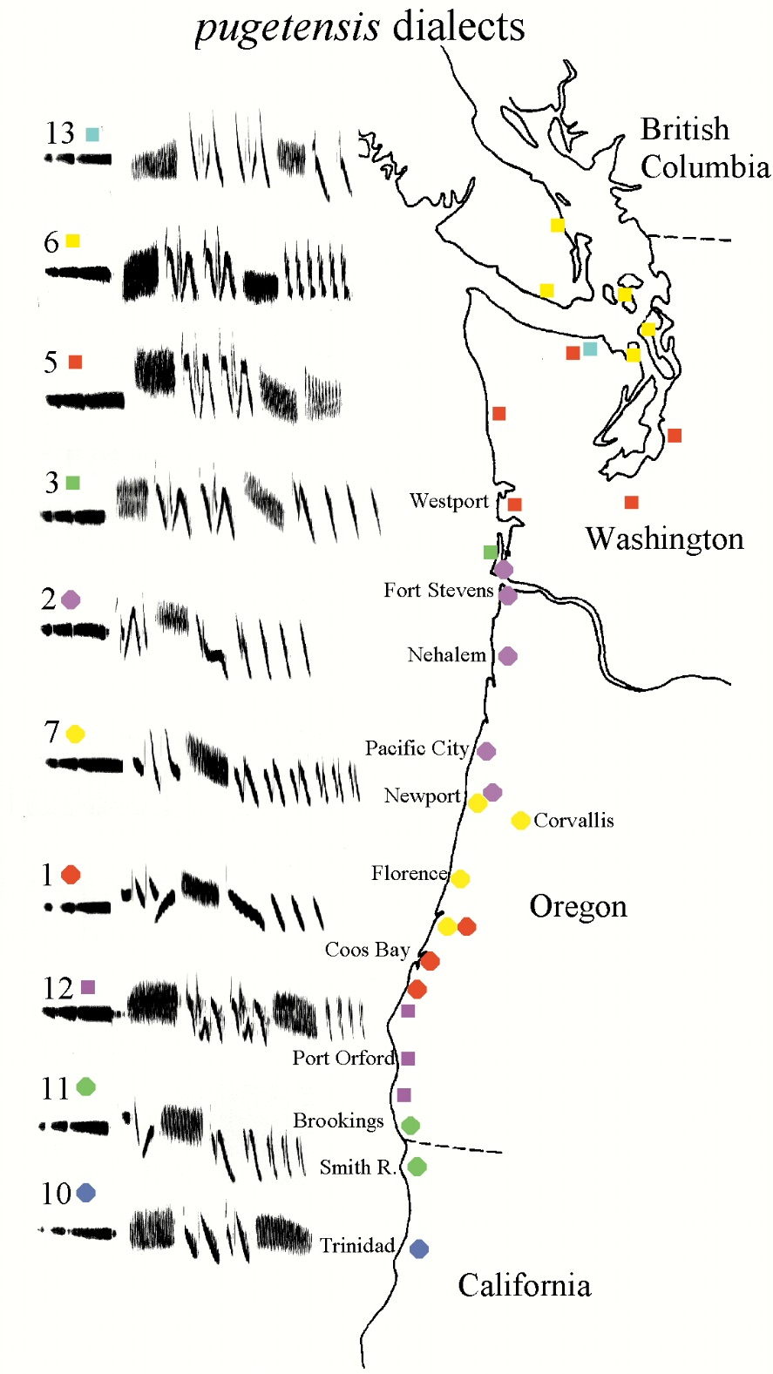
Marler & Tamura (1962) Condor
Notes:
Even beyond the complexity of vocal learning, this is the biological definition of culture!

Slide 15
Birdsong as a model for vocal learning
i) dependent on learning
ii) critical periods
iii) babbling phase
iv) dialects
v) syntactic structure

Slide 16
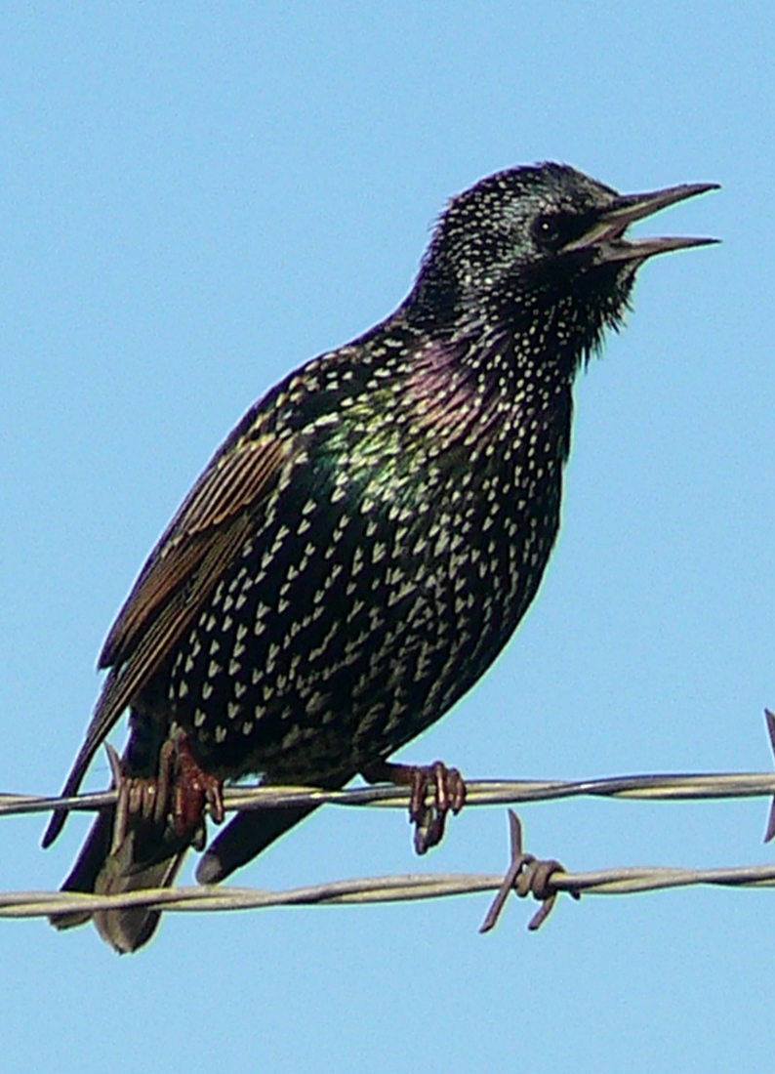
10 kHz
1 sec
syllables
motif
phrase
song
Gentner et al (2006) Nature
Notes:
>>Here, you’re seeing a spectrogram<<
Vocal recursion

Slide 17
Birdsong as a model for vocal learning
i) dependent on learning
ii) critical periods
iii) babbling phase
iv) dialects
v) syntactic structure
vi) specialized brain areas for vocal learning

Slide 18
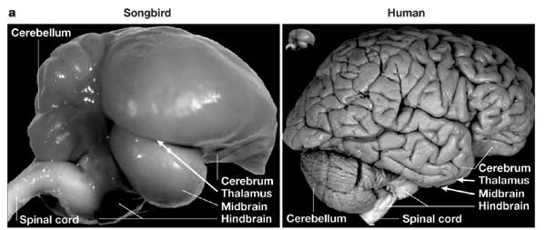

Slide 19
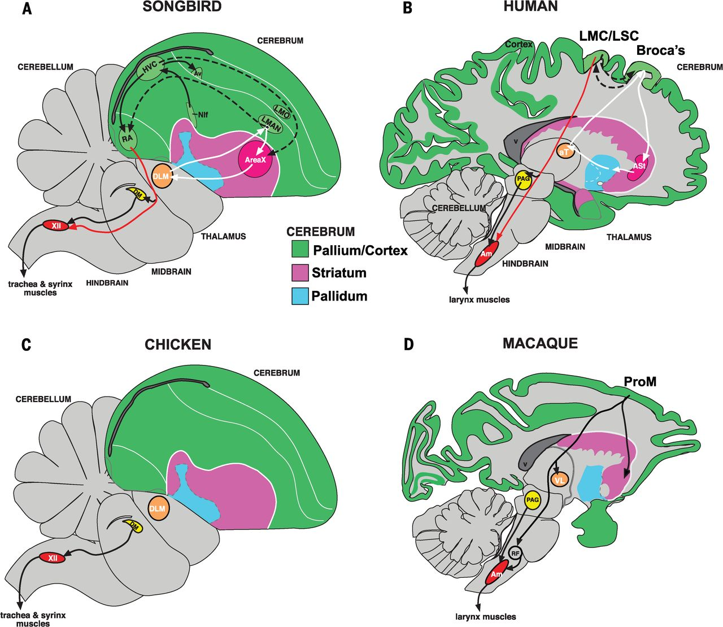
Reiner et al (2004) J Comp Neurol
Notes:
Song system solely devoted to vocal behavior.
Distributed nuclei (amenable to experimentation) as opposed to entangled cortical layers
We have a deep understanding of cell types involved in behavior, their anatomical interconnectivity, and electrophysiological properties

Slide 20
i) dependent on learning
ii) critical periods
iii) babbling phase
iv) dialects
v) syntactic structure
vi) specialized brain areas
for vocal learning
Genomic Basis?

Slide 21
How do brain circuits
for vocal learning evolve?
1) evolve new genes

Slide 22
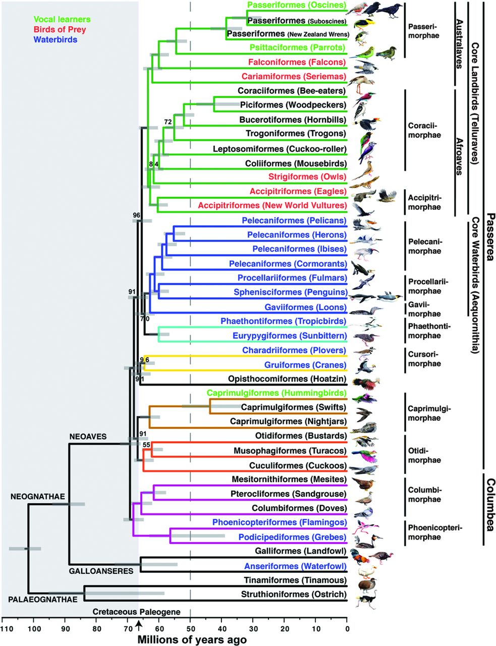
New avian tree of life based on full genomes
Jarvis et al
(2014) Science

Slide 23
Genes unique
to songbirds?
Jarvis et al
(2014) Science

Slide 24
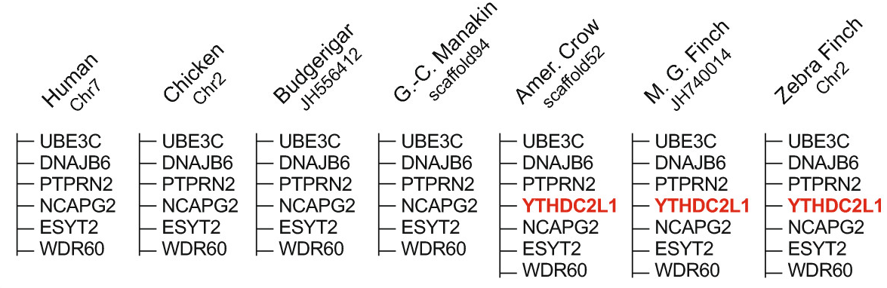
Gene locus-based strategy:
Wirthlin et al 2014, BMC Genomics
Notes:
As opposed to ‘orthology-based’ strategy
Use of multiple ingroups to ensure true presence (as opposed to assembly issues),
multiple outgroups to control for sequence incompleteness (not novel if it’s just unsequenced / assembled in your outgroup)

Slide 25
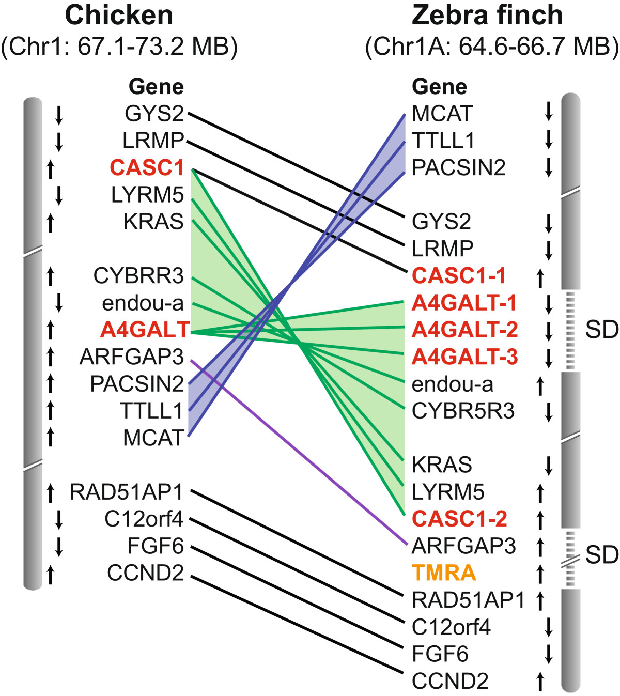
Novel genes evolve in
chromosomal breakage
‘hot spots’
Wirthlin et al 2014, BMC Genomics
Notes:
SDs: highly promising areas for novel gene discovery, only found through locus-based approaches

Slide 26
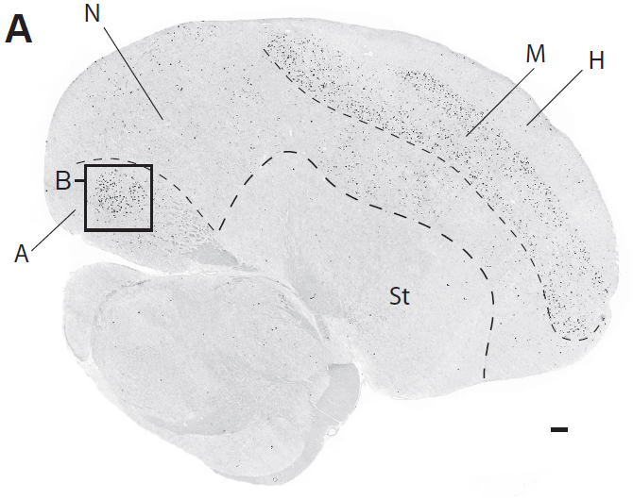
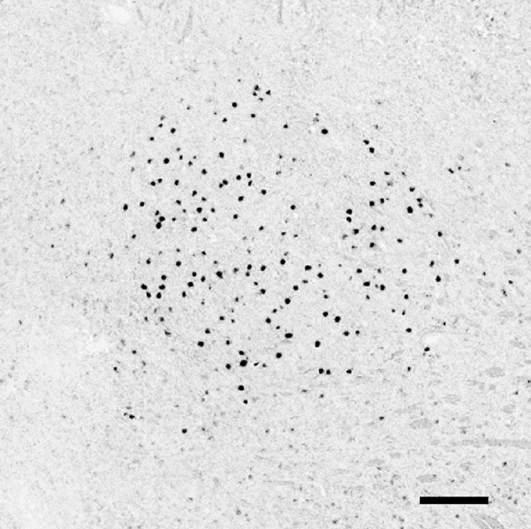
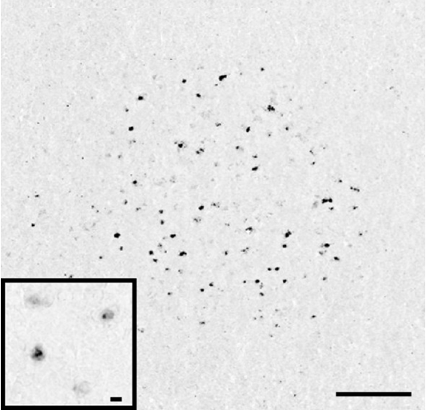
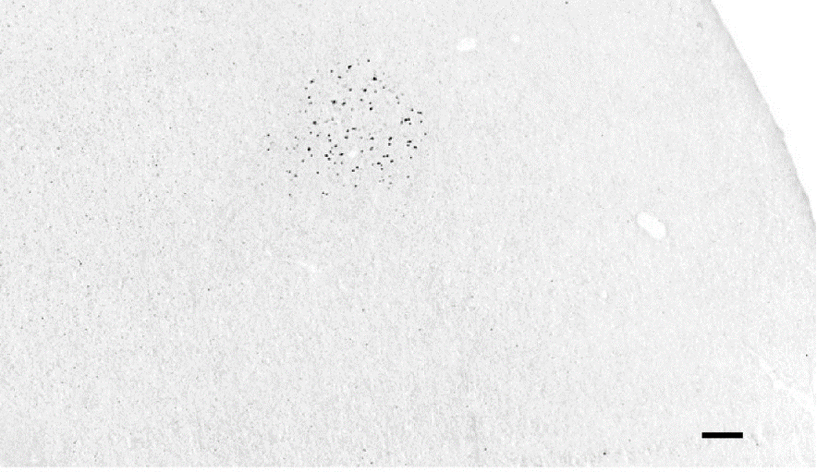
Songbird-unique genes active in vocal circuits
Novel gene:
TMRA
YTHDC2L1
RA
Motor Gesture Control Center
LMAN
Variability generator
Wirthlin et al 2014, BMC Genomics

Slide 27
How do brain circuits
for vocal learning evolve?
1I) use old genes in new ways

Slide 28
Three lineages of avian vocal learners…
songbirds
parrots
hummingbirds
Jarvis et al (2014) Science

Slide 29
Analogous circuits for vocal learning…
Reiner et al (2004) J Comp Neurol

Slide 30
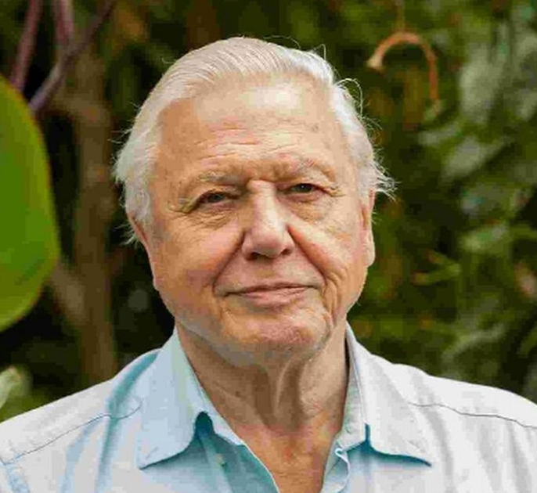
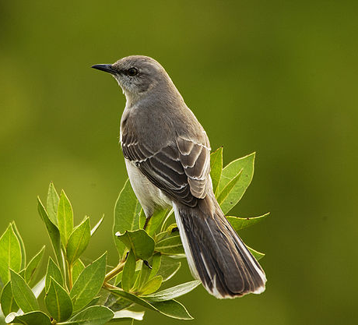
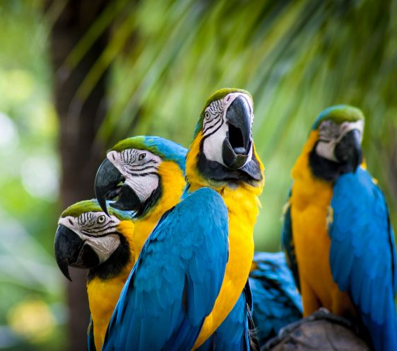
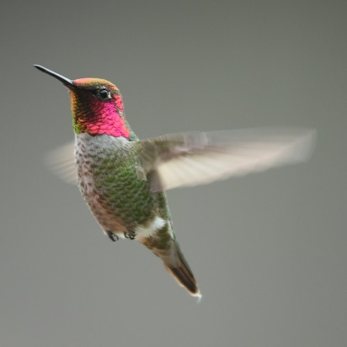
songbird-unique
human-unique
‘core’ vocal
learning
gene set?
hummingbird-
unique
parrot-unique
Notes:
Found songbird novel genes, parrot novel genes, HB novel genes are work in progress…
…unique novel genes could explain idiosyncratic behavioral features
But ‘core’ gene networks could reveal fundamental requirements

Slide 31
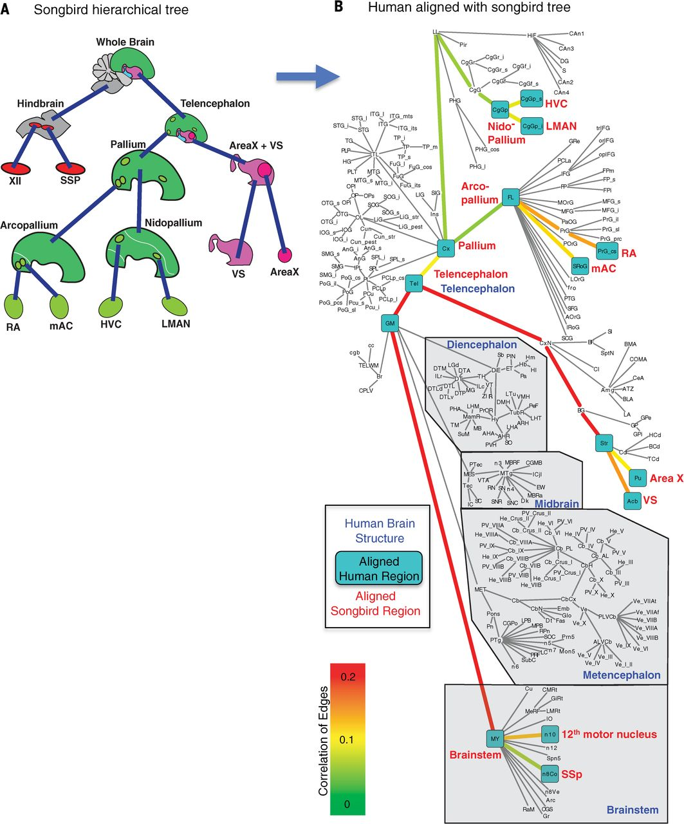
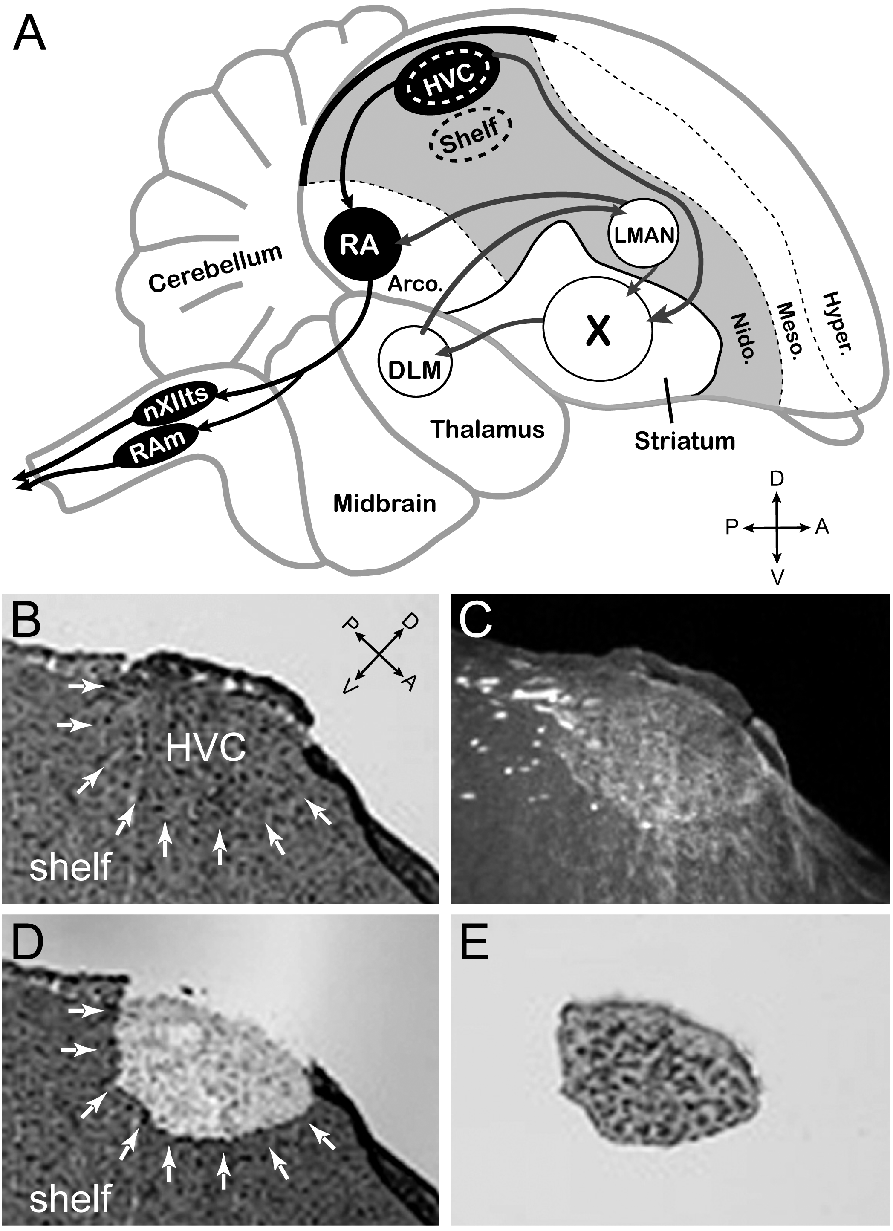
Pfenning et al
(2014) Science
Generate tissue-specific
gene expression databases
in songbirds, parrots,
hummingbirds, and humans…
blind analysis:
what regions show similar
gene expression patterns?

Slide 32
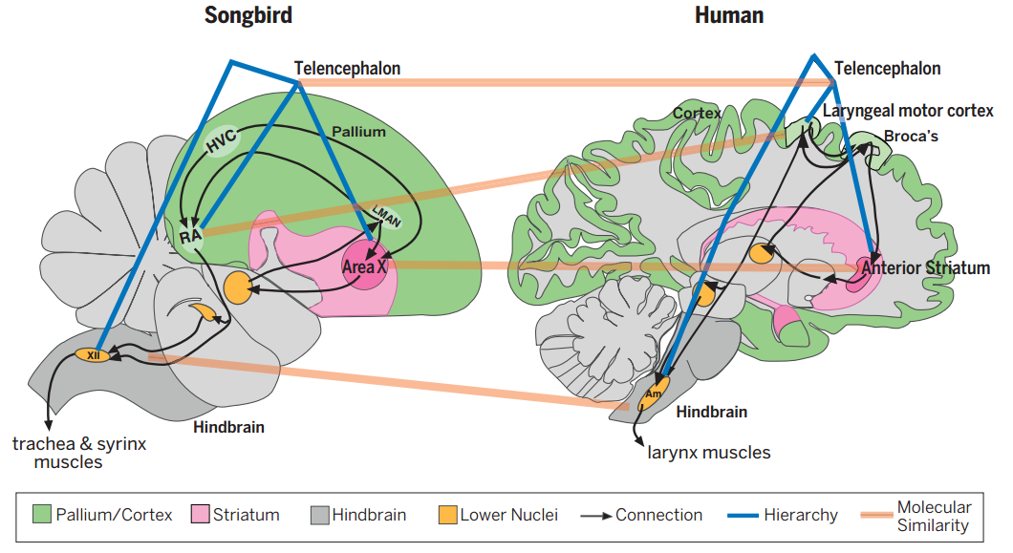
Shared molecular signatures for vocal learning!
Pfenning et al
(2014) Science

Slide 33
The space beyond genes…
~20,000 genes, ~1.5 % of the genome

Slide 34
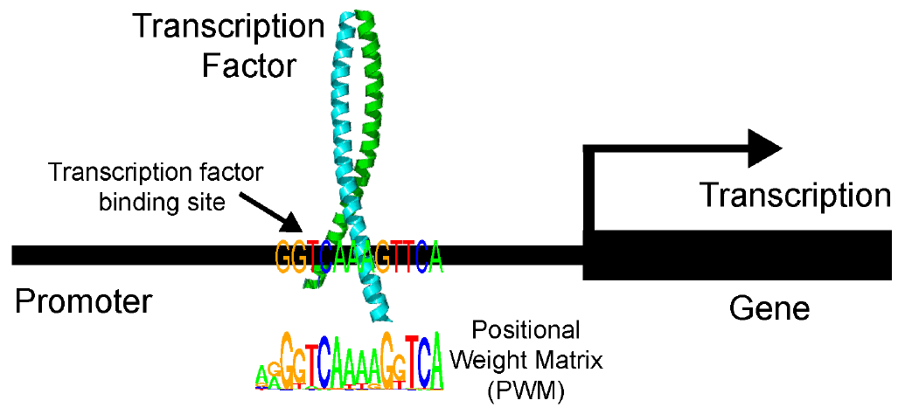
The space beyond genes…
~20,000 genes, ~1.5 % of the genome
Non-coding DNA
elements regulate
gene expression

Slide 35
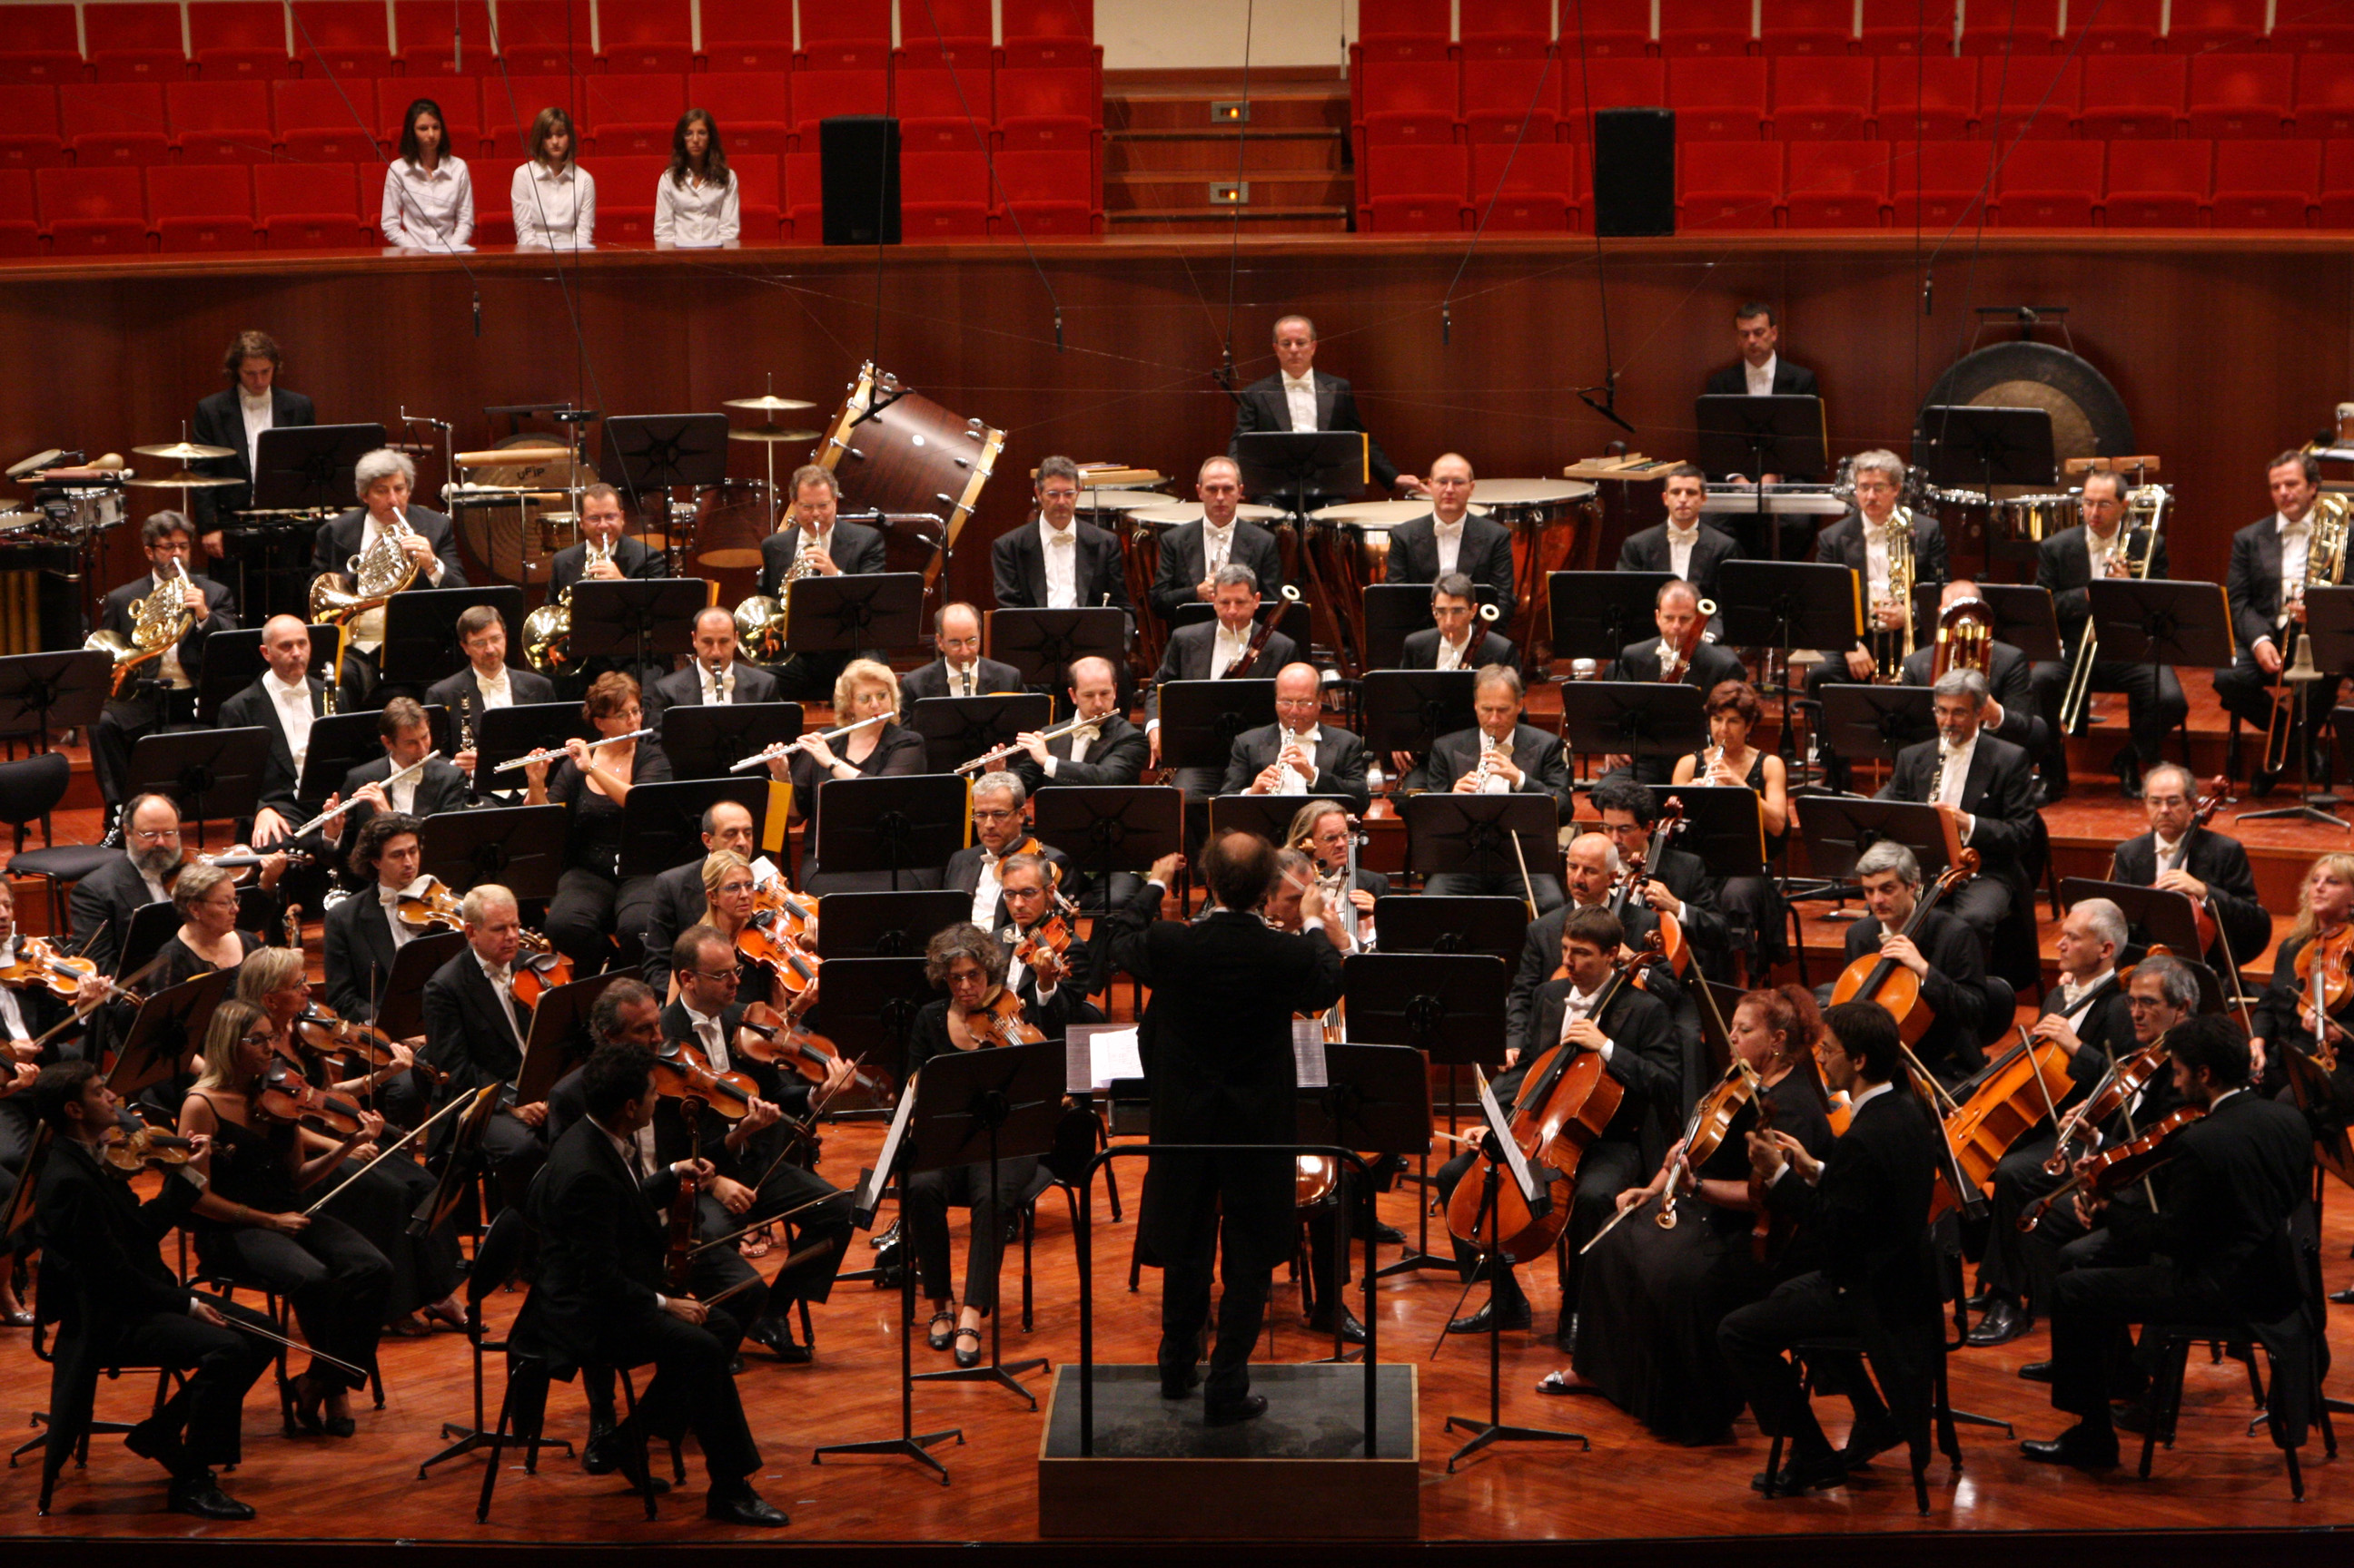

Slide 36
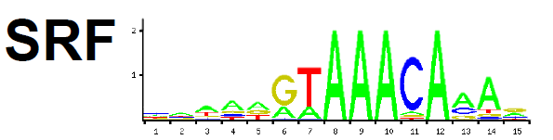
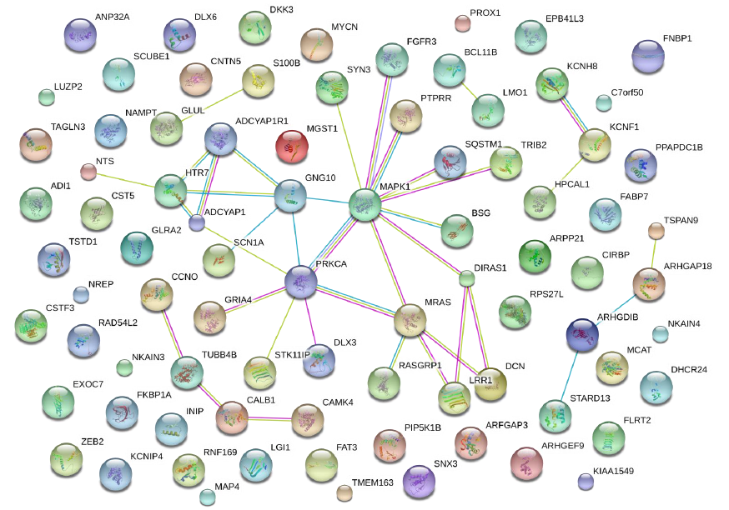
Transcription factors regulate song circuit genes

Slide 37
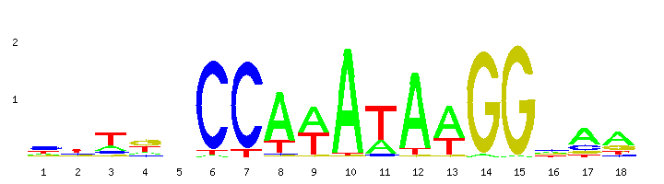
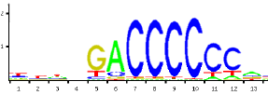

Could differences in non-coding DNA elements explain the circuit differences between learners and non-learners?
songbirds
parrots
hummingbirds

Slide 38



Thanks!
The Mello Lab at OHSU
Claudio Mello Peter Lovell Julia Carleton

Slide 39
Co-expressed gene sets contain underlying co-regulated gene networks
Enhancers / Promoters Genes
Co-expressed
gene set
Notes:
Genes going up or down, but resolution is limited to the nucleus, cell type, etc. Want subnetworks!
Can’t just rely on GO – ideally you are describing new networks too, beyond what is in databases, and these may actually be the most interesting ones!

Slide 40

Co-expressed gene sets contain underlying co-regulated gene networks
Enhancers / Promoters Genes
Co-regulated
gene network 1
Co-expressed
gene set
Co-regulated
gene network 2
Notes:
Can use regulatory motifs to subclassify networks

Slide 41
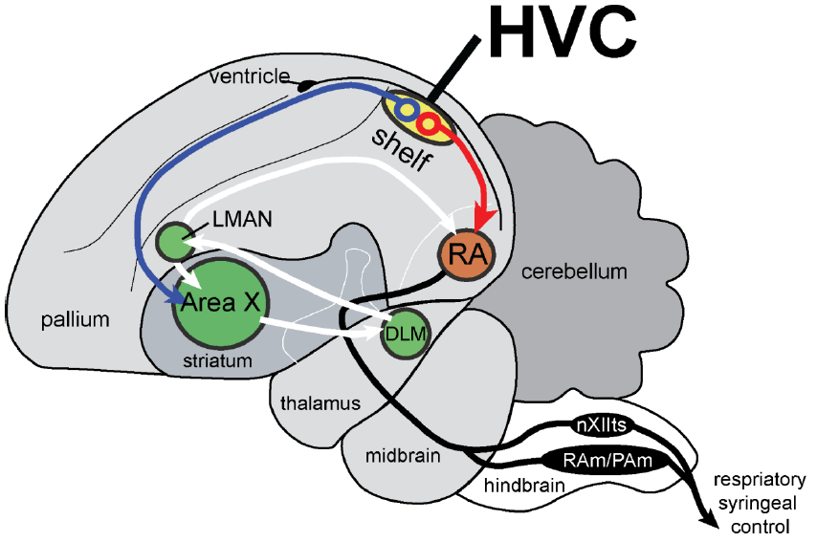
Goal: identify co-regulated gene networks underlying properties of:
1) vocal control nuclei
HVC, RA, Area X, nXIIts
2) vocal control nucleus cell types
HVC-to-X projection neurons
HVC-to-RA projection neurons

Slide 42
Goal: identify co-regulated gene networks underlying properties of:
1) vocal control nuclei
HVC, RA, Area X, nXIIts
2) vocal control nucleus cell types
HVC-to-X projection neurons
HVC-to-RA projection neurons

Slide 43
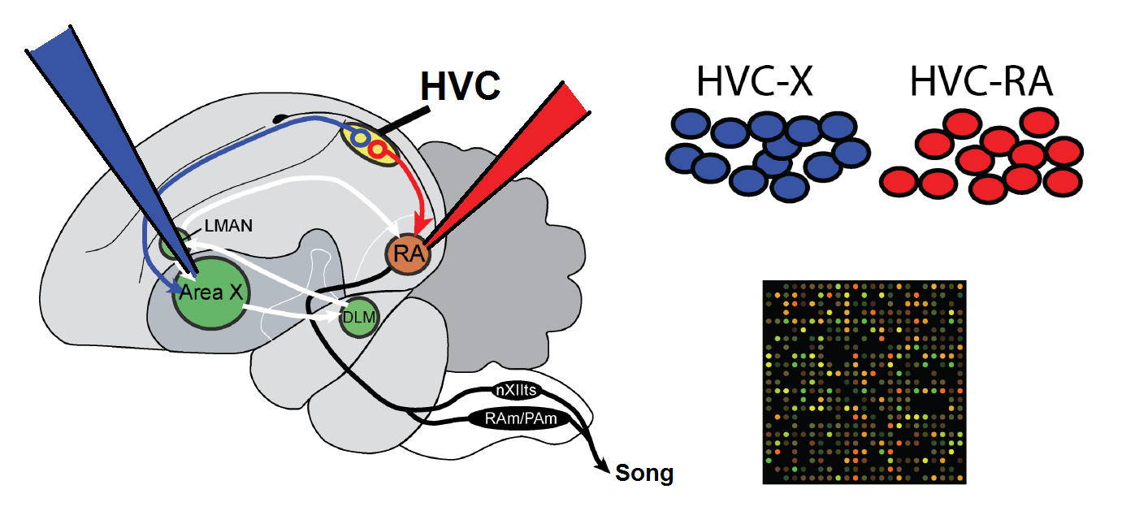
2) Laser capture microdissection
1) Retrograde labeling
3) Array profiling
Lombardino et al (2006) J Neuro Methods

Slide 44
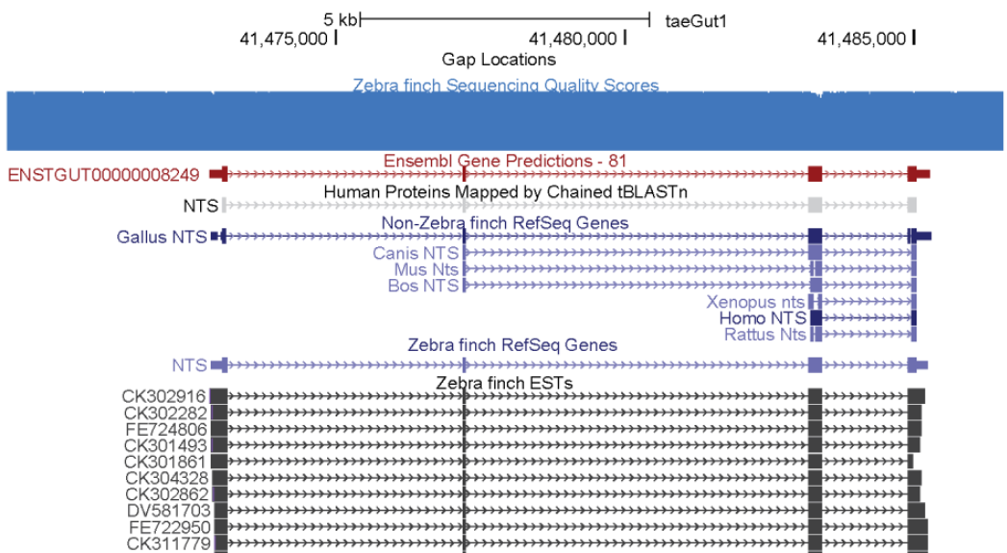
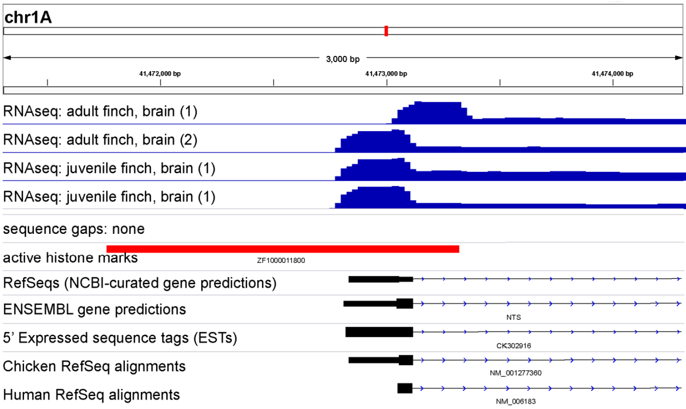
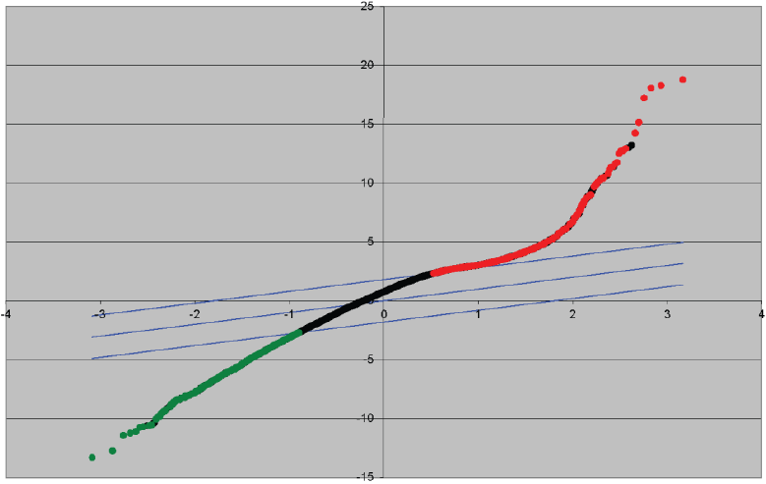
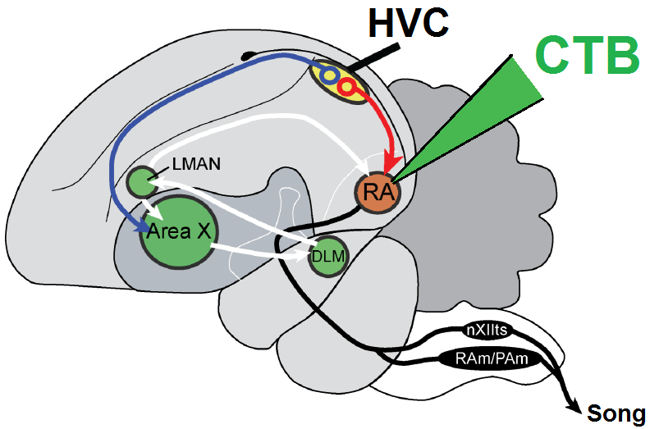
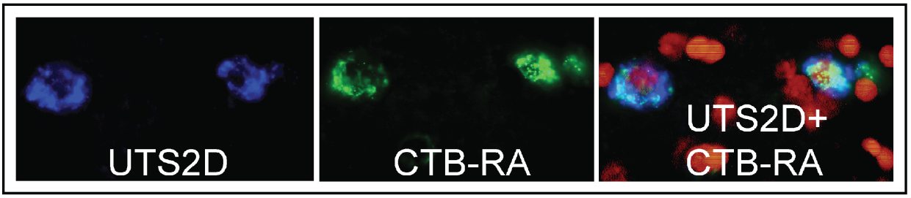
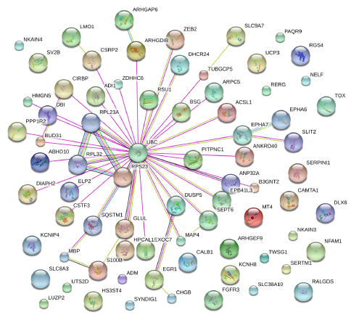
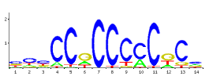
Cell type-specific promoter discovery pipeline
Observed Score
Expected Score
1. Probe filtering / QC
2. Differential Expression
3. Probe–to–Gene Curation
4. Tissue-specific 5’ UTR / TSS prediction
5. Tissue-specific promoter extraction
6. Validation through double fluorescent in situ hybridization:
HVC–RA neurons: 104 cell type marker genes
(confirmed through dFISH: n = 7 / 7, 100% confirmed)
HVC–X neurons: 44 cell type marker genes
(confirmed through dFISH: n = 7 / 7, 100% confirmed)
7. Promoter motif discovery
+ TFBS enrichment analyses
8. Functional gene network building
Notes:
RE: 7. enrichment: “multiple permutations relative to other cell types, other brain regions, full genome”?

Slide 45
FUTURE DIRECTIONS
Test predicted promoters + enhancers for their ability to drive cell type-specific expression in the brain
Assess evolutionary dynamics of regulatory sequences
Manipulate critical regulatory sequences in vivo
Notes:
#1: MPRAs, STARR-seq
#2: Do the same regulatory motif combinations drive independent evolutionary events of the same trait, or are there multiple paths?
#3: CRISPR: can we stop a bird from singing by cutting out crucial motifs? Of, if you like, can we get a chicken to sing?

