Slide 1
Technology Vortex of change
Rick Cnossen
Senior Director, Healthcare Solutions, Intel
Notes:
The vortex of change has never been greater.
Business models are being turned upside down a the hunters are now the hunted
Global equalization ensures that size is no longer a guarantee of success.
The innovative survive and thrive … the nervous and slow go under …
We are going to look at:
Disruptive opportunities
Re-inventing Enterprise IT to address
Sample platform
What does this mean for you in your industry?

Slide 2
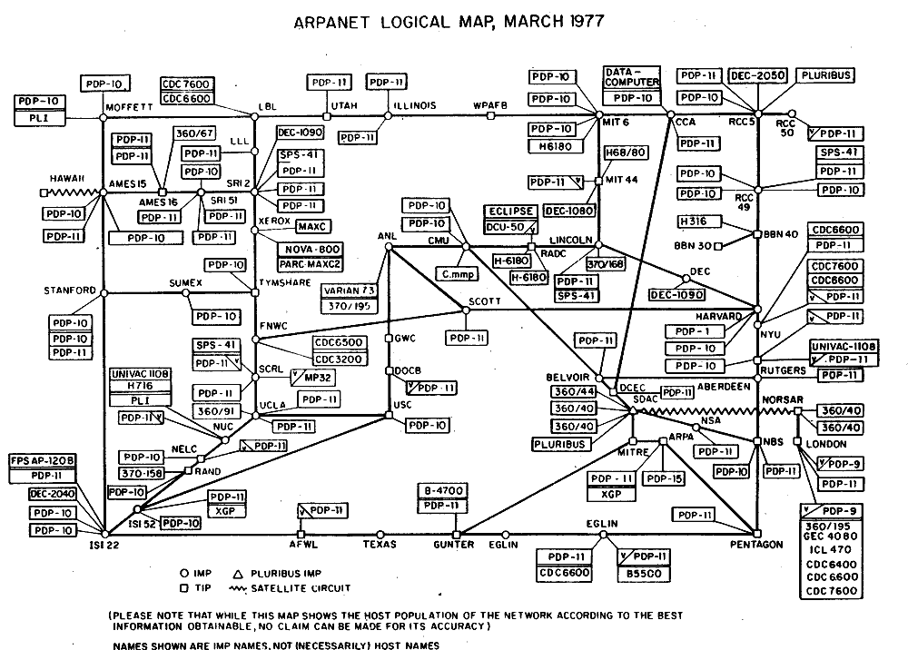
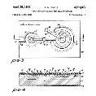
Every 100-150 Years We Hit an Accelerated Innovation Wave
2014
Machine Learning
3Bn
“If the Internet were a movie we’d still be in the opening credits” – Gord Graylish
Netflix
Google
2012
Embedded Intelligence in WTC
2003
Intel Centrino. WiFi Hot spots. Broadband
2Bn
1969 ARPANET (internet forerunner)
2010
iPad launched, other Android tablets follow
1983 First IBM PC compatible laptops
1991 Tim Berners Lee publishes World Wide Web
Google
1951
First Commercial Computer (Ferranti Mark 1)
1971 First microprocessor (Intel 4004)
1997
Google.com registered
Internet Users in the World
1959
Integrated Circuit is patented (Noyce/Kilby)
2007
iPhone launched
1Bn
2004
Facebook launched
1950
1955
1960
1965
1970
1975
1980
1985
1990
1995
2000
2005
2010
2015
Rise of the Connected, “as a Service” World Disrupts Entire Industries
…yet, 60% of the Worlds Population are Still Unconnected
Source: Internetlivestats.com; Intel 4004 photo: Hellisp / Wikipedia; Compaq portable photo: Geni / Wikipedia; iPad photo: mama_mia / Shutterstock.com; iPhone photo: Zeynep Demir / Shutterstock.com
Notes:
We’re in a period of accelerated innovation – some refer to it as the 3rd industrial revolution with the two prior being based around coal and steam and then in the early 1900’s around electrification. This one is driven by compute and communications.
With respect to the pace of change I’m often told it can’t get faster than it is today … or it was last year the year before !!
The reality is “this is the least amount of change we will ever see”

Slide 3
Notes:
Video

Slide 4
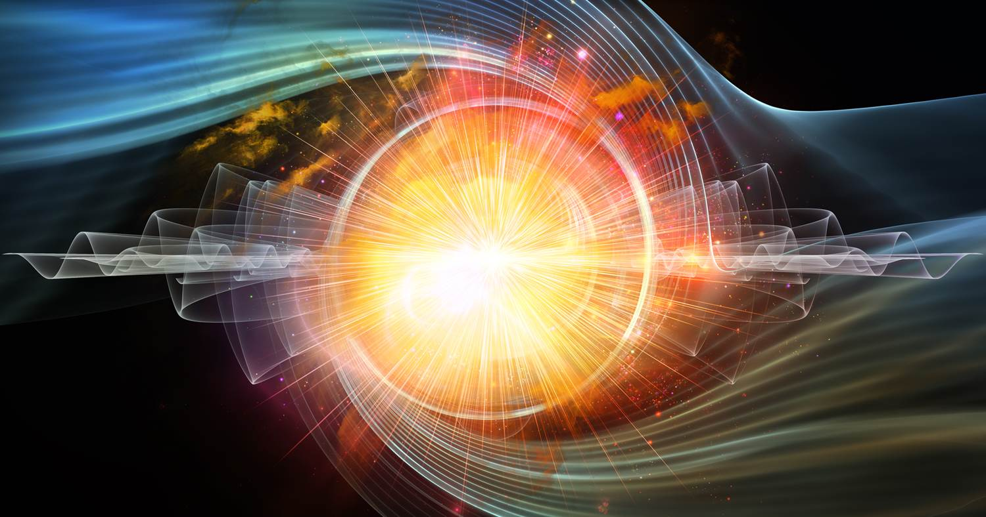
Disruptive opportunities

Slide 5
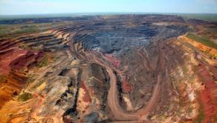
Disruptive Opportunity- Demographic Changes
New generations are born connected- expectation
Rise of mega cities
(3.6B ‘11 to 6.3B ‘50)
Emergent middleclass
(could be 2/3 by 2030)
Healthcare and Education
For Billions of People
10B people by 2050
(40% water stressed)
Relentless Cyber Threats
(McAfee-100K attacks/day)

Slide 6
Disruptive Opportunity- Security / Privacy
78%¹
79%¹
Global Data Sovereignty Rules
organizations take weeks to months to discover a breach
organizations take days to months to containment
CVV 3-digit security code
Bank a/c details
How much is your data worth? ($)
Black-market prices
PayPal / eBay account
2
5
27
3
5
10
20
32
45
ID Package (name, DOB, etc.)
Credit card (old)
Health credentials
Credit card (fresh)
Lowest
Average
Highest
Informationisbeautiful.net
1. Verizon 2013 Data Breach Investigations Report
2. Informationisbeautiful.net
Notes:
It’s one of the top board level imperatives
The business of cybercrime generates more than $1Trillion annually – more than twice the market for the global sale and distribution of drugs. This isn’t 15 years old kids in their parents garage. These are organized, sophisticated operations.

Slide 7
Disruptive Opportunity- Sharing Economy
“An economic system in which assets or services are shared between private individuals, either for free or for a fee, typically by means of the Internet.”
- The Oxford Dictionary
Airbnb
Uber
Upwork
“The unstoppable rise of the Sharing Economy”
Liquidspace
Feastly
Kickstarter
LendingClub
Other names and brands may be claimed as the property of others.
Notes:
Radical disruption underway
AirBnB (disrupt hotel)
UBER (disrupt taxi)
LiquidSpace (disrupt workplace)
KickStarter (disrupt venture capital)
oDesk (disrupt employee model)
Feastly (disrupt restaurant)
LendingClub (disrupt bank)

Slide 8
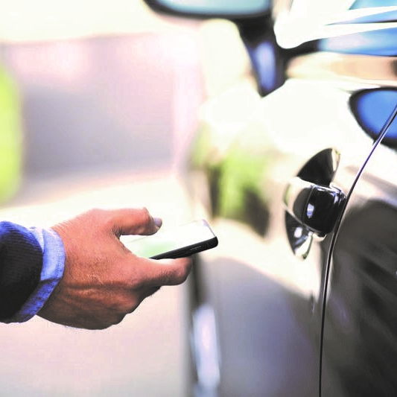
UBER as a Disruptor
Founded in 2009
Employees - ~1000¹
Locations – 58 countries²
Valuation ~$50Bn³
Shared, autonomous vehicles could reduce new car sales 40% over next 25 years. – Barclays¹
U B E R
“Uber …will eventually be cheaper to use than owning a vehicle”
“Uber plans to take 400,000 personal vehicles off the road and create 50,000 jobs in Europe this year” ⁴
- Travis Kalanick
Have we reached “Peak Car” ?
Sharing Business
1. Source: http://fortune.com/tag/barclays/
1 Source http://www.inc.com/christine-lagorio/how-uber-hires.html
2 Source https://www.uber.com/cities
3 Source http://www.forbes.com/sites/chrismyers/2015/05/13/decoding-ubers-50-billion-valuation-and-what-it-means-for-you/
4 Source http://time.com/3672852/uber-europe/
Other names and brands may be claimed as the property of others.

Slide 9
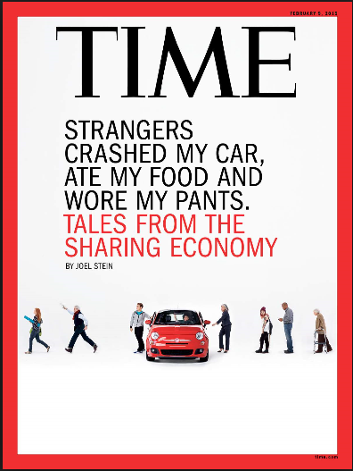
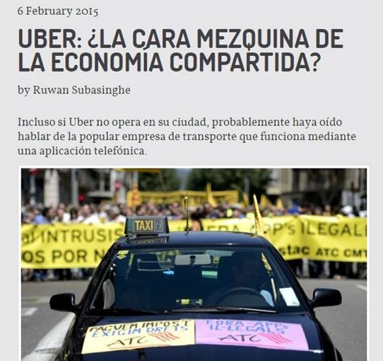
And… It’s Not Without Its Teething Troubles
1
2
Hot areas for debate…
Regulation
Legal
Tax
Public Safety
Insurance
Social Acceptance
Data Protection
Data Privacy
1 Source http://time.com/3686877/uber-lyft-sharing-economy/
2 Source http://www.equaltimes.org/uber-la-cara-mezquina-de-la?lang=en#.Ve2AVvlVj3Y
Other names and brands may be claimed as the property of others.
Notes:
Ack some rough spots but value of transformation is overcoming and increasing growth (despite critics)

Slide 10
re-inventing the enterprise
Notes:
As we see traditional business converging with new digital business, we need to re-invent Enterprise IT to accommodate.
What does that look like?

Slide 11
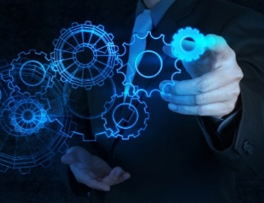
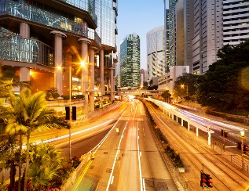
Digital business =
+
+
+
+
+
Data Driven
Smart World
On-Demand
Trusted
Connected Experience
Innovative Workforce
Corner stones of New economy Business winners
Notes:
Data Driven (Data is a new currency)
Smart (IOT context)
On-Demand (delivery of services in minutes not days)
Trusted (Heart of your brand identity)
Experience (Connected, Immersive, Safe)
Innovative (Stay competitive)

Slide 12
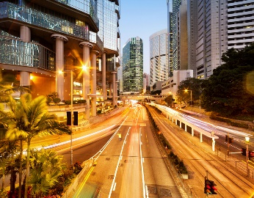
Delivering Transformative business Outcomes
+
+
Data Driven
(Big Data)
Smart
World
(IoT)
On-Demand
(Secure Cloud)
Transform Business with trusted, real-time data
Drive operational excellence and revenue via extended insights
Reduce IT/ Operational Cost; increase agility
+
+
Connected Experience
(Perceptual Computing)
Innovative Workforce
(Business Client)
Trusted
(Security)
Reduce business risk protect brand value
Win and retain customers with stunning connected experiences
Ignite innovation and productivity through transformed workplaces
Digital Business Platform
Notes:
How to deliver transformative business outcomes!
For each:
What leaders are doing
Rhetorical questions
Where puck is going

Slide 13
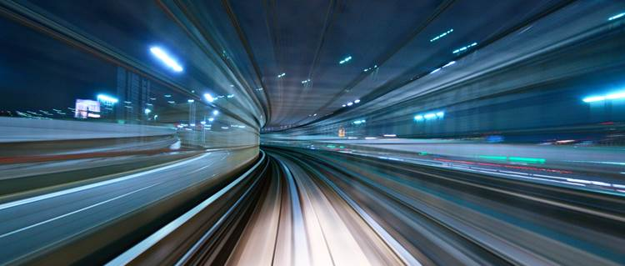
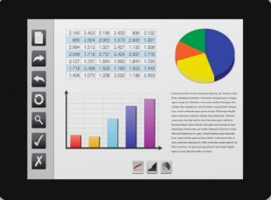
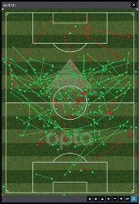
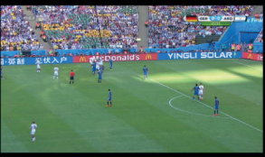
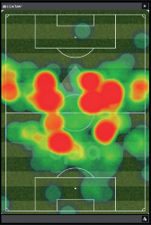
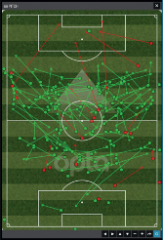
Data Driven
How will you derive value from your data?
Sentiment Analysis / Ad Customization
Bridge Maintenance, Parking, Patient Safety
Sentiment Analysis / Ad Customization
Bridge maintenance, parking, patient safety
Do you have a BIG DATA strategy?
Personalization & Context
Operational efficiency & safety
Personalization & Context
Operational efficiency & safety
What barriers are holding you back?
Smart Assistants, Gas Price
Skin Cancer, Genomics
Democratization of Analytics
Data as a Service
Smart Assistants, Gas Price
Skin Cancer, Genomics
Transform your business with trusted, realtime data
Democratization of Analytics
Data as a Service
Other names and brands may be claimed as the property of others.
Notes:
Everyone has been told “we need to do “Big Data” – let’s look at some applications

Slide 14
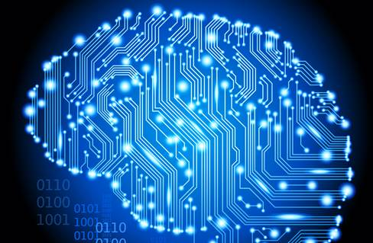
Data Driven – Areas to Watch
Emerging Usages
Analytics moving to the cloud
01010101010101010101010101001111000011011110001101010010
Hamburg Port Authority
Data Hubs
Google voice recognition / Netflix Recommendations
Machine Learning & AI
Other names and brands may be claimed as the property of others.
Notes:
Hamburg port authority – gather and aggregate information from many sources – shipping, containers, on land transportation, weather, maritime, retail and many others. It allows the port and their mass of ecosystem partners to gain insights that drive a much more efficient and predictable operation that based on reality vs guesswork.
AI – Google uses AI for voice recognition!.

Slide 15
Smart World (IoT)
Operational Excellence
Revenue Growth
Operational Excellence
Revenue Growth
GE Engines /
Traffic management
Pay parking /
Time-of-day-based toll road
GE Engines /
Traffic management
Pay parking /
Time-of-day-based toll road
What use cases would improve operational excellence in your business?
Optimization
Charge
Optimize
Charge
What use cases could increase your revenue?
Remote control and access/ Telemedicine
Send digital content / Software upgrades
Remote control and access/ Telemedicine
Send digital content to thing/ Software upgrades
Operate
Extend
drive operational excellence and revenue growth via extended insights
Operate
Extend
Source: Optimize, Charge, Operate, Extend model - Gartner
Notes:
There are two major areas where folks are trying to realize value- Operational Excellence and Revenue Growth.
With Tesla- you go to bed one night, wake up the next morning and new updates/services have been delivered overnight. Seamless, non invasive – customers love it.

Slide 16
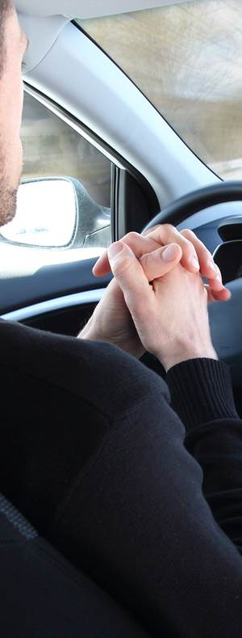
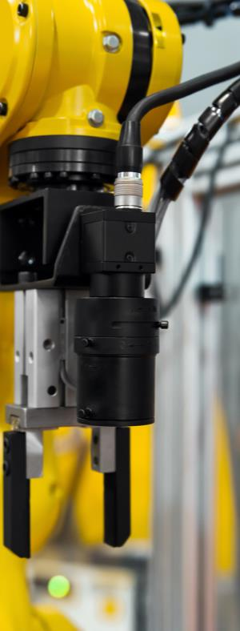
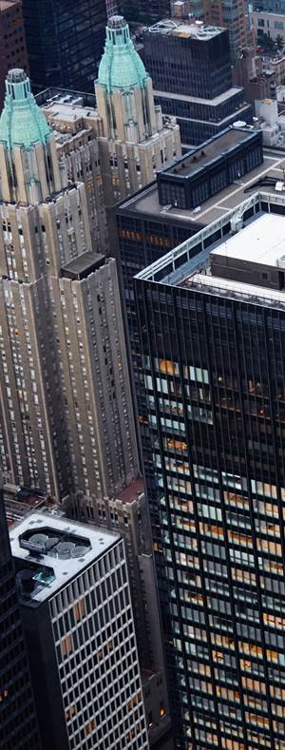
Smart World – Areas to Watch
Autonomous Vehicles
Transport
Robots
DRONES
Maker Community
Shared Power Economy
Energy
Smart Cities
Notes:
Where’s this all going?
What are some of the areas we see movement in? Autonomous- all major manufacturing and DARPA (ship)
Robots/drones– natural disasters, accidents when emergency services can’t get there quickly
Power- distributed grid
Last but not least is the Smart City –Transport, Home, Infrastructure

Slide 17
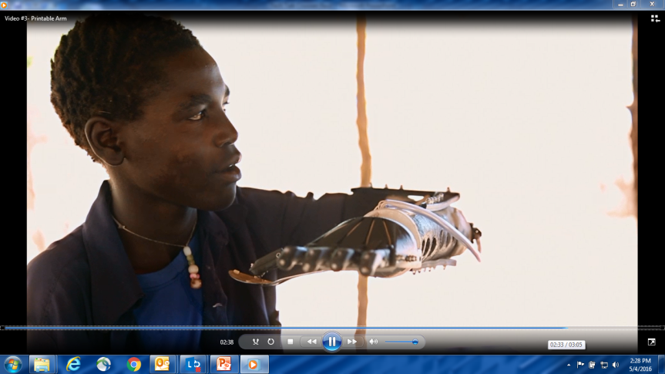
Notes:
IoT- use compute to refine, learn; Japan exoskeleton

Slide 18
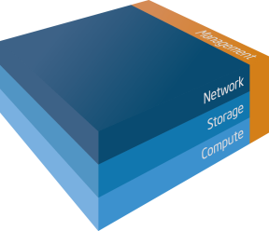
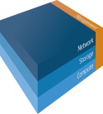
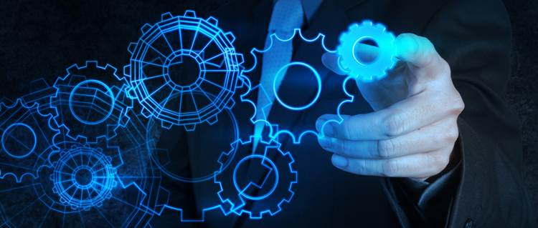
On-Demand …with Cloud
Cloud: Increase agility whilst reducing operational cost
Software Defined Infrastructure
IaaS, PaaS, SaaS
Weeks to Days, Hours to Minutes
IaaS, PaaS, SaaS
Weeks to Days, Hours to Minutes
Industry leaders embrace SDI Private Cloud infrastructure
As a Service
Agility/Response
As a Service
Agility/Response
Do you have a strategy for Software Defined Infrastructure?
Orchestration and Automation
API’s e.g. “DHL button”
Orchestration and Automation
API’s e.g. “DHL button”
Cloud Economics
Open for Innovation
Cloud Economics
Open for Innovation
Other names and brands may be claimed as the property of others.
Notes:
Move to everything as a service – platform, software, infrastructure .. data … HPC…, security .. emerging.
Intel server- weeks to hours
DHL button

Slide 19
Trust How Exposed Are You?
“Trust is won in drips, and lost in buckets”
- Malcolm Harkins, Chief Security & Privacy Officer, Intel Corp.
Reduce business risk and protect brand value
with security and privacy
Notes:
Trust – At the Heart of Your Brand Identity – Won in Drips, Lost In Buckets - Think about that for a moment. It takes years and years of hard work and effort to build a trusted brand – and that can be lost in an instant. We only have to look at recent history – Target, South Korea, eBay…
Security needs to be a top business imperative since trust is ultimately at the very heart of your brand identity.

Slide 20
Security by Design : In the DNA of Your Organization
BUSINESS OBJECTIVES
In light of the daily reporting on breaches has your company taken action?
CULTURE
What do you expect from your security partners?
ARCHITECTURE
How do you approach developing or enhancing a security minded culture?
INSIGHTS
Enable Your Business to go FAST, SAFELY
Notes:
Security by Design. It means Security shouldn’t be treated as an extra or an add-on; it should instead be part of the fabric of the organization. In the DNA of everything you do.

Slide 21
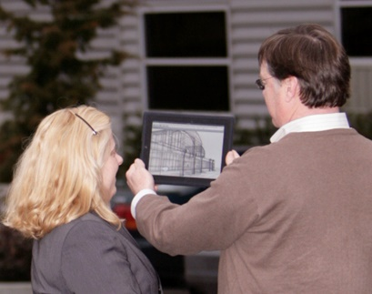
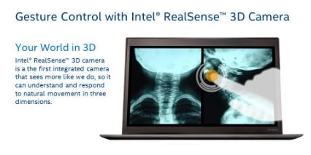
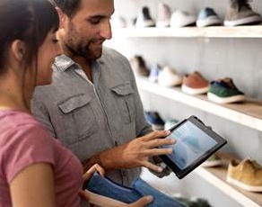
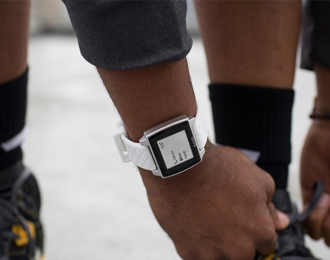
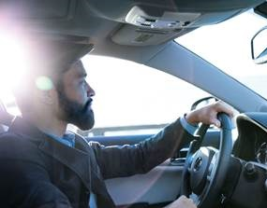
Connected Experience
An Interconnected Mesh of Mobile Devices, Data, People
What Digital Experience do your customers expect?
Gesture Control and Facial Recognition common place
Language Barriers will be eliminated
Augmented Reality enhances the physical world with digital
Gesture Control and Facial Recognition common place
Language Barriers will be eliminated
Augmented Reality enhances the physical world with digital
How will your business differentiate itself online ?
Win and retain customers with stunning connected experiences
Wearables– ubiquitous compute interwoven with everyday life
Self Driving Cars
Marriage of Silicon and Biology, Advances in Prosthetics
Wearables– ubiquitous compute interwoven with everyday life
Self driving cars
Marriage of Silicon and Biology, Advances in Prosthetics
Source: Booz Allen Hamilton

Slide 22
Innovative Workforce
A Backdrop of Unprecedented Corporate Change
40%¹ of top F500 in 2000 are no longer there in 2010
Only 7%²
Innovation
Velocity
Openness
of Gen Y work for F500 company, preferring start-ups
75%²
Gen Y will form
Foster and rewards innovation
Market led agility
Aligning incentives
Democratize ideas Shared and connected
of workforce by 2025
Businesses have to re-imagine how we work: critical need to innovate and increase velocity
1 source: Brian Solis Future of Business
2 source: Brian Solis Future of Work
Notes:
Igniting Innovation and Productivity Through Transformed Workplaces
talent – acquisition, development and retention. If as a company you can’t attract the right talent, you have a problem.

Slide 23
Innovative Workforce
How are you going to close the innovation and productivity gap in your business?
“Rise of the Human Cloud” Collaboration, Social
Fundamentally transform the style/nature of work- smart workspace
Talent retention and acquisition (esp. Millennials and Digital Natives)
The Reality!
Ignite innovation and productivity through transformed workplaces
Notes:
Collaboration
Peer-peer touch/gesture interactive collaboration, Life-like HD video/voice call, Automated Meeting transcription,
Enable Business Users to Connect, Collaborate and Share Globally Without the traditional Barriers
Wire Free Workplace
An environment where the inconvenience and burden of wires – network, display, electrical power, docking – is gone
You are your password
Smart Workplaces + Smart Buildings
The room “knows” I’m here and automatically sets up, Immersive and natural AV, Support for Intuitive touch/gesture content sharing

Slide 24
’SMAC’ – THE THIRD PLATFORM
Notes:
SMAC – Third Platform – Mainframe and Client Server were the first two

Slide 25
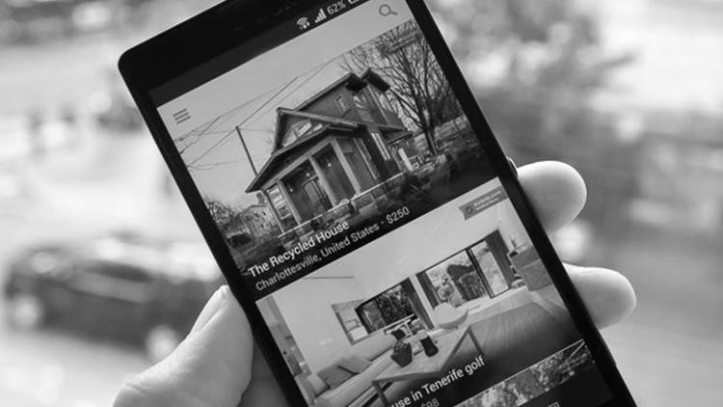
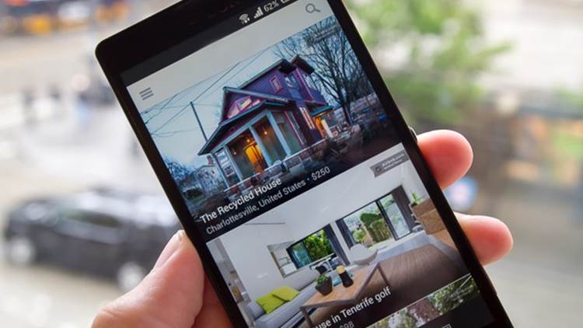
Social
Mobile
What’s making this all possible?
The SMAC Stack
Analytics
Cloud
Notes:
Social - Democratizes ideas and opinions (24x7, global); eliminates traditional hierarchies for communication
24 x 7 global source of information
Mobile – Work/play/consumer anywhere anytime. Everything can be sensored and connected.
Analytics – Filtering of information to create observations, predictions, and drive new real-time decision making (e.g., diseases, phone calls0
Cloud - Access to information for collaboration anyplace, anytime. Device and data synchronization.
This is simply didn’t exist 5 years ago. It enables business models to be created and scaled at incredible pace.

Slide 26
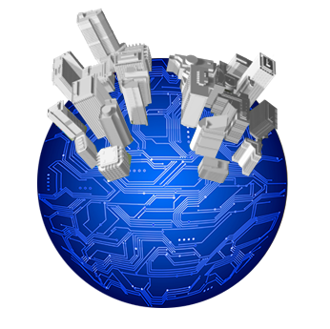
SMAC Disrupts Traditional Business, Adds New Ones
Amazon
Facebook
Uber
ebay
Wikipedia
zipcar
Spotify
Tencent
Airbnb
Kickstarter
Baidu
LendingClub
Netflix
Apple
Twitter
Feastly
Alibaba
Google
UpWork
Other names and brands may be claimed as the property of others.
Notes:
Examples of companies using SMAC
What do many of them have in common? No legacy?
That plus SMAC allows them to respond at incredible pace to create and change their business models and offer services to their customers in day and weeks vs months and years.

Slide 27
Intel / MJ Fox SMAC Platform for Parkinson’s
Big data analytics
IOT
Notes:
Andy Grove- CEO of Intel has Parkinson’s
He saw an article in the NY Times about Big Data / Analytics and proceeded to apply it to his disease.
We are now working with MJF to combine strengths

Slide 28
Parkinson’s Disease
1/100
1M/US
60,000
NEW
5M/WORLD
^{OVER AGE 0F 60}
^{NO CURE,}
MEDICATION ONLY HELPS WITH SYMPTOMS
^{There is} ^{NO TEST}
^{and no}
^{PROGRESSION}
^{MARKER}
PARKINSON’S DISEASE IS CAUSED BY THE DEATH OF DOPAMINE CELLS.
^{60 80%}
^{TO}
OF THESE CELLS ARE ALREADY LOST BY THE TIME MOTOR SYMPTOMS APPEAR.
Notes:
Let’s first understand what it is… a Neuro-degenerative disease- movement disorder
Slow progression / management difficult

Slide 29
Please raise your hand, if you can articulate how you have felt in the last 12 months in comparison to the previous year.

Slide 30
You can't Manage what you can't
Measure
Notes:
Slow progression
Limited data
Infrequent doctor visit
Incomplete self reporting
Patients don’t want PD define them !

Slide 31
The Solution
1
Wear a watch
2
Start an application
Notes:
Unobtrusively collect data 24 x 7 x 365
Provide value to patient
In own environment
They want to use

Slide 32
Use Cases
^{RESEARCHER}
FREE DATA FOR 1000’S OF PATIENTS
^{MANAGE THE DISEASE USING DATA}
^{ANALYTICS}
^{BIG DATA CLOUD}
^{CLINICIAN}
ACCURATE REPORT SINCE LAST VISIT
^{INSIGHT / VALUE}
^{PHARMACEUTICAL}
^{MEASURE MEDICATION EFFECT}
Notes:
There is a fourth beneficiary which is the patient.
We have 500 connected users today…. Looking to 1000’s in 2016

Slide 33
Wearable Cloud Analytics Framework
Downstream Export
Analysis & Mining tools
Analytics Platform
Data Platform
Self reported – Questions, Feedbacks, Medication reporting
Structured tests – Gait, Alternating hand movement
24/7 analyzed data– Activity, Tremor, Sleep
Cloud Infrastructure
33

Slide 34
Vortex of change
closing thoughts
Notes:
Disruptive Opportunities
6 elements for successful digital business
SMAC platform

Slide 35
Questions to leave you with…
Which areas of your industry are ripe for business transformation?
How is your company embracing any of the new economy business models?
Will you lead the charge? If not you, who?
Notes:
Closing questions
Thank you for your time and attention today.

