Slide 1
-- +
Transposition in a Nutshell
Mitigating Transmission Power Line Losses
Without Breaking the Bank
Autumn Engh
OIT BSREE/MSREE, Bonneville Power Administration

Slide 2
What Does
Electricity
Mean to You?

Slide 3
100%
have access
to Electricity
In America
20%
Electrical
losses
on average

Slide 4
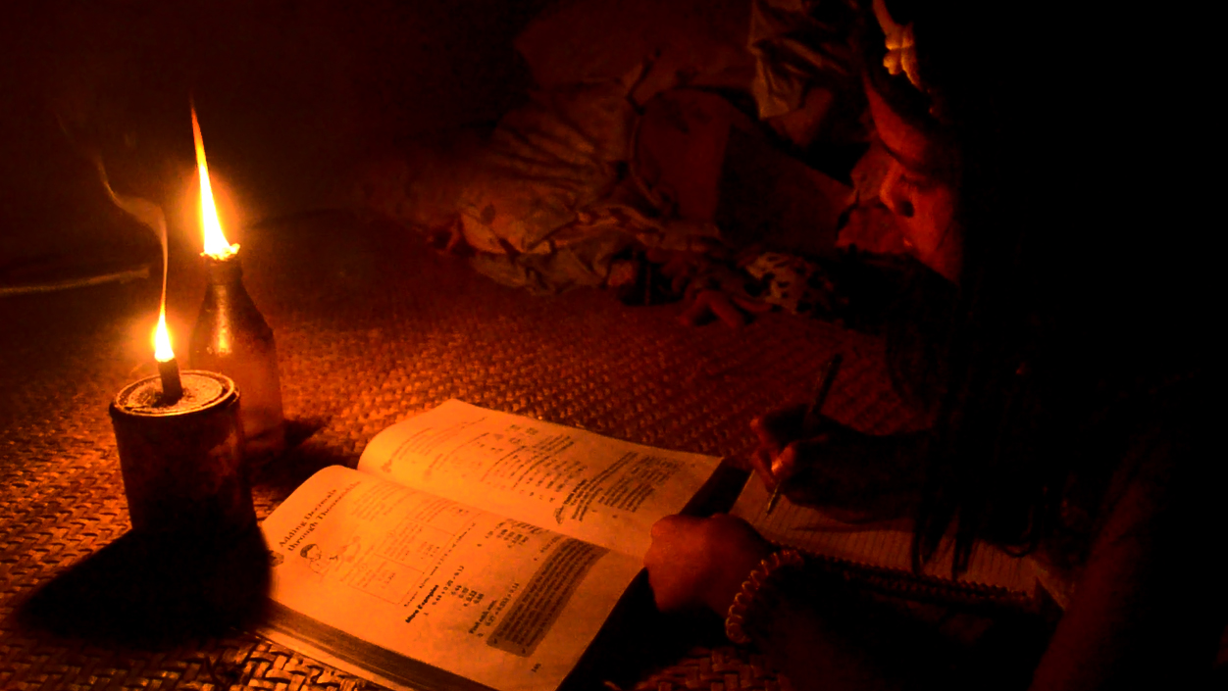
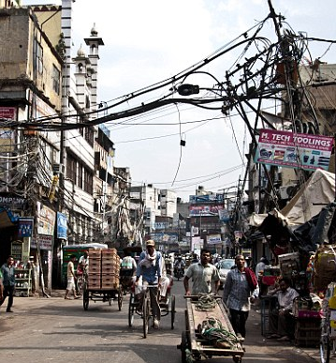
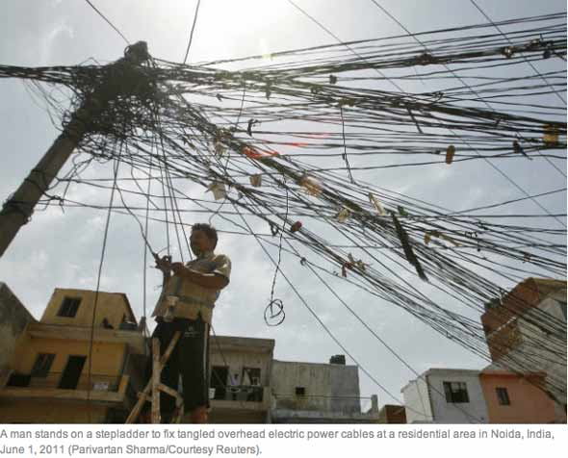
80% Electrical
losses
at best
Globally
1 in 6
don’t have Electricity

Slide 5
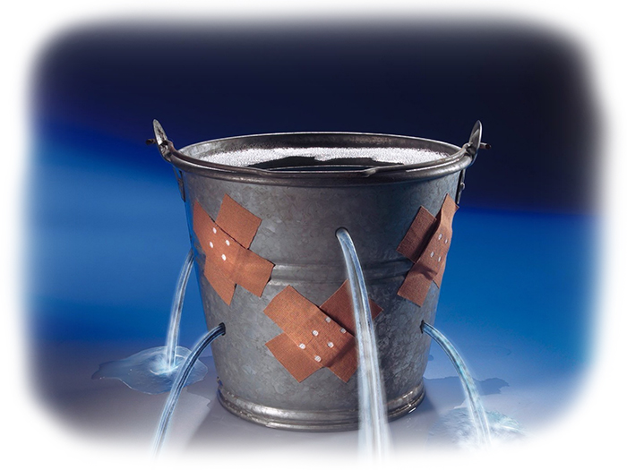
Portland’s Current Electrical Grid

Slide 6
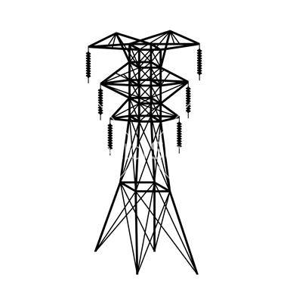
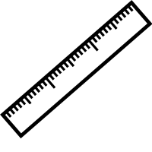
B Ø
A Ø
C Ø
100%
100%
75%
75%
50%
50%
25%
25%
0%
0%

Slide 7
Possible Electrical Losses:
50,000 Homes
Notes:
This is the problem.
Current standards are between 25-300 miles. Coupling doesn’t even start until 50 miles.

Slide 8
Electricity to Meet Demand
↑ Electricity
Demand
No ↑ Profits
Consumers
Generation

Slide 9
Like Working for Free
Electric Co.

Slide 10
YAY Transposition Fairy
(who looks suspiciously like, but is definitely NOT a copyrighted character)
B Ø
A Ø
C Ø
100%
100%
75%
75%
50%
50%
25%
25%
0%
0%

Slide 11
Transposition Standard
Not Needed
Definitely Needed
Ask an Engineer
25
300
Length of Line (miles)

Slide 12
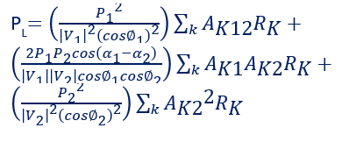
Current Method
My Solution
Calculate Electrical Losses:
$$∯_{∂Ω}{E∙dS= }\frac{1}{εo}\iiint_{Ω}{ρdV}$$
$$∯_{∂Ω}{B∙dS}=0$$
$$\oint_{∂∑}{dℓ}=−\frac{d }{dt}\iint_{∑}{B∙dS}$$
$$\oint_{∂∑}{B∙dℓ}=μo\iint_{∑}{\left(J+εo\frac{∂E}{∂t}\right)∙dS}$$
65 miles
P_{L}$=\sum_{p=1}^{m}{\sum_{q=1}^{m}{PpBpqPq}}$
B_{pq}$=\frac{cos\left(αp−αq\right)}{\left|Vp\right|\left|Vq\right|cos∅pcosl;\backslash ∅q}\sum_{K}{AKpAKqRK}$
…
I_{L}$i=\left[\frac{\sqrt{(PLi2+QLi2}}{\left|Vi\right|}\right]\left\lfloor \underline{δi−∅i}\right.$
Calculate Construction Costs:
l$nC =αo+α1X1+α2X2+$ $α3X3+\text{α}\text{4}\text{X}\text{4}\text{+}α5X5+$ $α6X6+α7lnX7+α8lnX8$
EXECUTE
Value of Money over Time:
PV$=\sum_{t=1}^{N}{Ct{\left(1+r\right)}^{−t}}$
Equate and Compare
65 miles

Slide 13
NO TRANSPOSITION
∑ Transposition Costs
∑ Profits ↓
TRANSPOSITION

Slide 14
Safety first!
B Ø
A Ø
C Ø
100%
100%
75%
75%
50%
50%
25%
25%
0%
0%

Slide 15
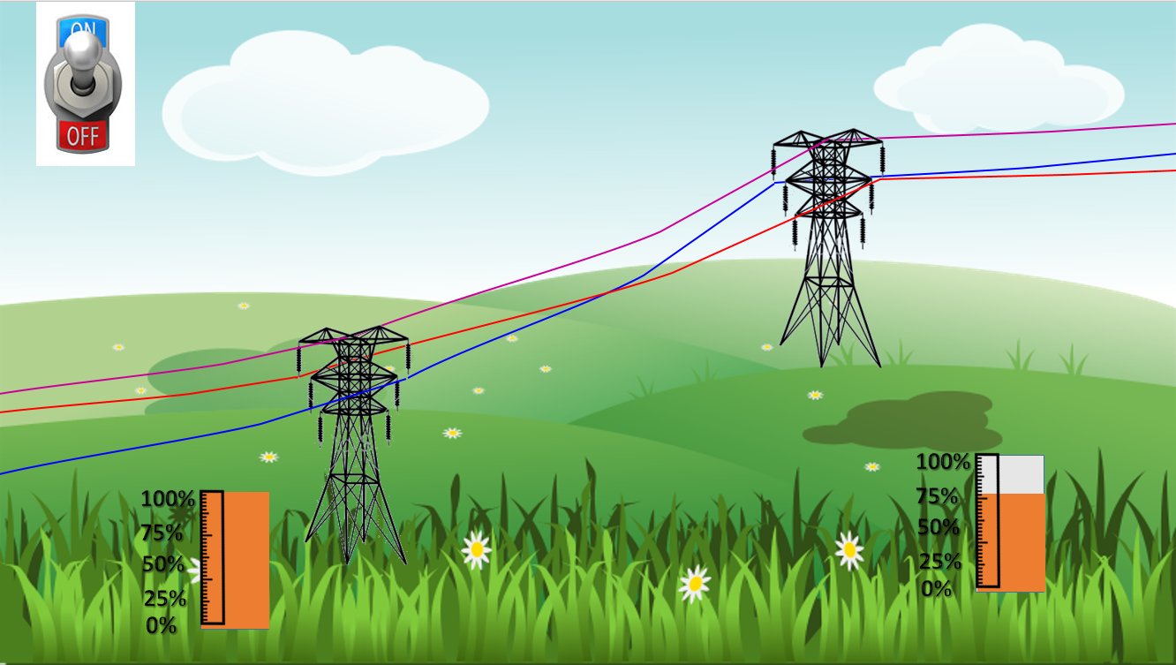
Transposition!!!
B Ø
A Ø
C Ø
100%
100%
75%
75%
50%
50%
25%
25%
0%
0%

Slide 16
Power UP
B Ø
>5% ↑
A Ø
C Ø
100%
100%
75%
75%
50%
50%
25%
25%
0%
0%

Slide 17
5% ↑
Most Conservative Estimate Using Transposition:
+18,000 Homes
Notes:
This is the problem.
Current standards are between 25-300 miles. Coupling doesn’t even start until 50 miles.

Slide 18
Energy Consumption Forecast
quadrillion BTU’s
Present
OECD
$310 billion in potential profits by 2040
0
200
400
600
800
1,000
NON-OECD
1990
2000
2012
2020
2030
2040
courtesy of EIA.gov
$1.7 trillion in potential profits by 2040

Slide 19
Who would you rather be?
Notes:
Engineer vs computer

Slide 20
What would you rather spend?
Notes:
Engineer vs computer

Slide 21
The End
Notes:
Engineer vs computer

Slide 22
ALL WILL BOW BEFORE YOUR EFFICIENCY

